Slide 1
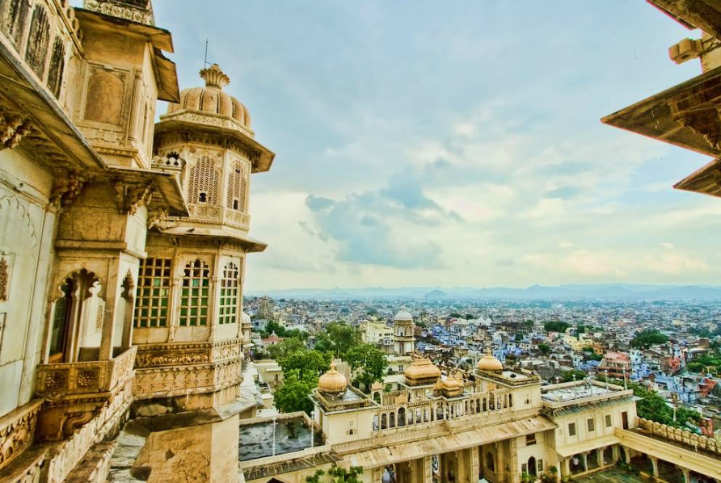
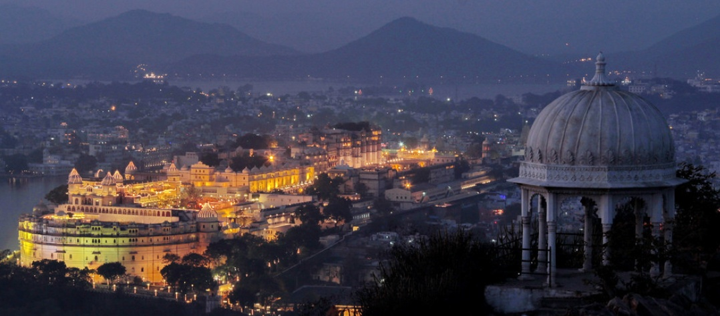
REVIEW : Implementation of Smart Cities Mission
UDAIPUR SMART CITY LIMITED
Udaipur, Rajasthan
23rd February, 2017

Slide 2
Udaipur Smart City
SPV & PMC
1
Funds, etc.
Fund Utilization Certificate:
QMP:

Slide 3
Udaipur Smart City
REVIEW OF PROGRESS OF PROJECTS
LIST OF PROJECTS – WORK IS IN PROGRESS/COMPLETED
SL. NO. | NAME OF WORK | BRIEF DETAIL
1 | Development of Open Air Gymnasium at Gulab Garden | USCL issued Work order amount of Rs. 8.62 Lacs. Work completed.
2 | Conservation & Development Works of Heritage façade, Lighting & Signage’s for Historic Bazaars in the Walled City, Udaipur under package for Udaipur Smart City Project Phase-I | USCL issued Work order amount of Rs. 599.32 Lacs. Work under progress.
3 | Setting up Smart Class Rooms in Government Schools of walled City Area Udaipur | USCL issued Work order amount of Rs. 79.21 Lacs. Procurement of material for 20 classrooms completed and installation work of 11 classrooms completed
4 | Installation of Solar roof top in Government Buildings in the ABD (Walled City) Area | REIL has been authorized as implementing agency for Jaipur and Udaipur. Agreement signed with REIL and 40% fund transferred of total cost Rs. 1.61 Crore for seven government building in wall city area. Installation of Solar panel of capacity 190 KW on roof top completed.
5 | Construction of Control and Command Centre Building | USCL issued Work order amount of Rs. 1.22 Crore. Site cleaning work completed. Due to poor soil testing report, revised Structural design and planning received by DOIT. Ground floor slab casted and Column work for first floor under progress. Revised structural design and planning received by DOIT.

Slide 4
Udaipur Smart City
REVIEW OF PROGRESS OF PROJECTS
LIST OF PROJECTS – WORK IS IN PROGRESS/COMPLETED
SL. NO. | NAME OF WORK | BRIEF DETAIL
6 | Parking lot development work at PWD Garage near Gulab Bag, Udaipur | To provide parking facility in the wall city area. USCL issued Work order amount of Rs. 48.55 Lacs. Work Under Progress.
7 | Progress under SBM | To facilitate door to door collection of solid waste in the wall city area USCL purchased 15 auto tippers, on 26-12-2016 worth Rs. 67.24 Lacs and handed over to Nagar Nigam.
8 | URBAN MOBILITY - Operation of E-Rickshaw in the Udaipur city under NMT | EOI issued for E-Rickshaw under NMT on 12-08-2016 and received techno-commercial offer on 31-08-2016 by Shree Padmavati Online Services Pvt. Ltd under the Brand Name NamasteJi to operate the Service of E-Rickshaw in the specified locations for a period of 5 years. POC issued to bidder for 6 months.
9 | SOCIAL INFRASTRUCTURE - Installation of Automated Sanitary Vending Machine at Important places | USCL proposed to install Automated Sanitary Vending Machine approved by MoUD at girl's colleges, Hospitals, Bus stand, Railway stations etc. For this M/s HLL Lifecare Ltd. (Govt. of India Enterprises) has been contacted and USCL has issued order for 55 machines and dispersed 50% advance. Till today 49 machines have been installed and 6 will be installed in this month.

Slide 5
Udaipur Smart City
Projects – Core Infrastructure (Overall)
RfP under Process
N.B. The Cost is based on the pro rated Budgeted Cost available against the individual modules from the TOR. This has been done because of the absence of individual Budgeted Cost of line items
For Details on Progress made : Refer Slides 6-12

Slide 6
Udaipur Smart City
NEW WORKS PROPOSED
SL. NO. | MODULE | PROJECTS | REMARKS /EXPECTED DATE OF ISSUE OF RFP
1 | SEWERAGE | Planning and Elimination of all points of sewerage discharge into lakes and Dismantling of existing underwater sewerage system in Pichola lake – Pollution abatement in Pichola Lake by trapping Waste Water coming from Sisarma Village and pumping into SPS-5 | Work completed related to the preparation of Proposal for the issue related to Pollution abatement in Pichola Lake by trapping Waste Water coming from Sisarma Village RFP completed and submitted to USCL. EXPECTED DATE OF ISSUE OF RFP: FEBRUARY, 2017
2 | WATER SUPPLY | Design and Implementation of Water Supply with SCADA system | WAPCOS is preparing detailed project report under AMRUT mission and it has been proposed for 24x7 water supply in the ABD area. EXPECTED DATE OF ISSUE OF RFQ: FEBRUARY, 2017 IT WILL BE PART OF THE INTEGRATED RFQ DOCUMENT THAT WILL BE FLOATED WITH RESPECT TO WATER SUPPLY, SEWERAGE, ELECTRICAL, UTILITY DUCTING AND ROAD RESTORATION

Slide 7
Udaipur Smart City
NEW WORKS PROPOSED
SL. NO. | MODULE | PROJECTS | REMARKS /EXPECTED DATE OF ISSUE OF RFP
3 | UTILITY DUCT & ELECTRICAL | Preparation of DPR for Laying composite Utility Duct | RFQ already prepared as part of the Integrated Tender Document EXPECTED DATE OF ISSUE OF RFQ: FEBRUARY, 2017 IT WILL BE PART OF THE INTEGRATED RFQ DOCUMENT THAT WILL BE FLOATED WITH RESPECT TO WATER SUPPLY, SEWERAGE, ELECTRICAL, UTILITY DUCTING AND ROAD RESTORATION

Slide 8
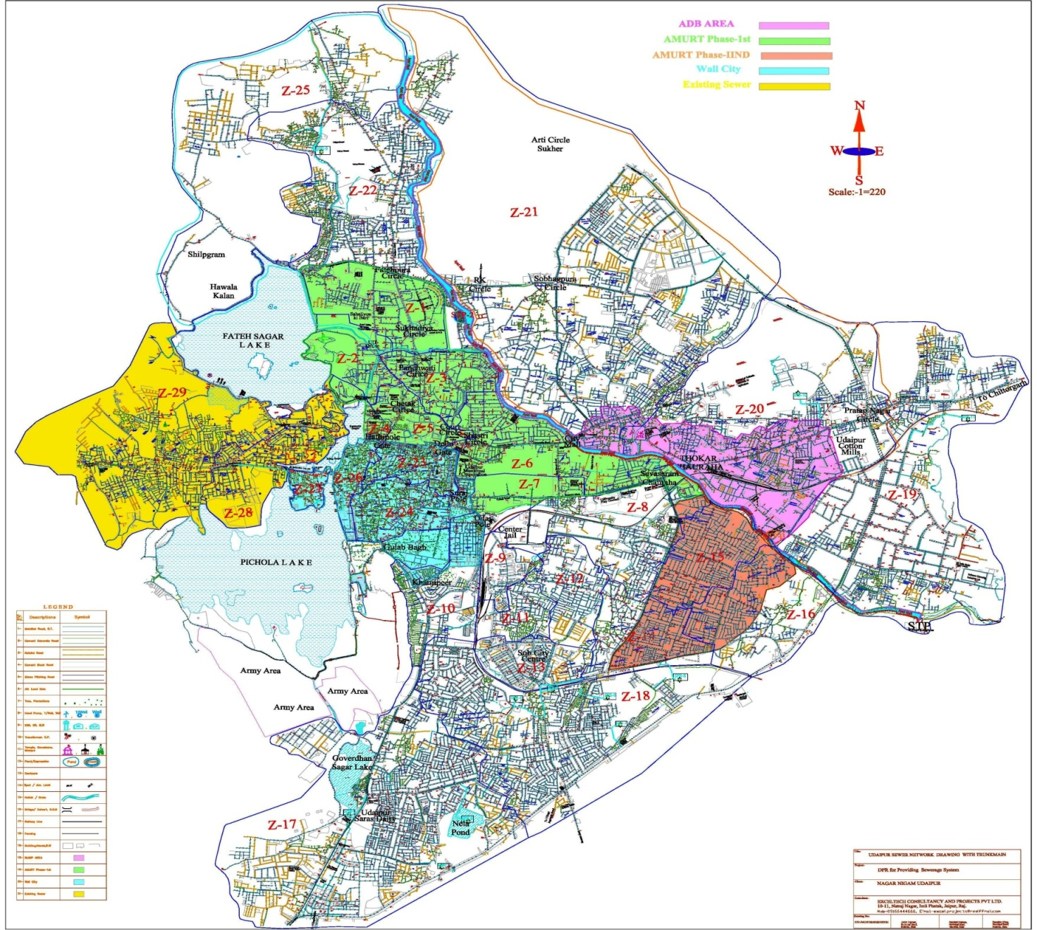
Udaipur Smart City
NEW WORKS PROPOSED
4. Integrated Sewerage Project
INR 80 Cr.
INR 149 Cr.
INR 75 Cr.

Slide 9
Udaipur Smart City
NEW WORKS PROPOSED
Integrated Sewerage Project
(A) PROPOSALS IN PHASE - II
Developing a cluster of the following works:-
Integrated DPR of complete town was got prepared by ULB. AMRUT, Smart City and RUIDP project are going to be executed now. To execute the sewerage work in a holistic approach and to avoid overlapping, combined cluster has been proposed as below:-
Remaining work of amount Rs. 75 crore under AMRUT to be executed near to sanctioned area under AMRUT Phase-I, covering 44412 households i.e. increasing coverage by 7.58%.
Retrofitting of old sewer lines of walled city area under Smart city by condition assessment and using pipe bursting technology of amount Rs. 149 Cr plus 45 Cr under AMRUT for convergence.
Installation of STPs at following location under HAM (Hybrid Annuity Model) and 40% contribution will be under convergence to Smart city mission-
25 MLD at Eklingpura
10 MLD at FCI Godown
5 MLD at Karjali house

Slide 10
Udaipur Smart City
NEW WORKS PROPOSED
Integrated Sewerage Project
Integrated sewerage detail project report (DPR) of AMRUT phase-II and walled city area of SMART CITY with decentralized STP's work has been prepared by Municipal Corporation and got sanctioned in SLTC meeting dated 25-10-2016 of amount Rs. 304 Crore. USCL is currently getting the same vetted and then issue tender in two lots.
In the walled city area, replacement and laying of new sewerage line shall be done by pipe bursting trenchless technology (Rehabilitation of existing sewers by Pipe Bursting / CIPP Technology) as open cut excavation is not feasible in the narrow lanes of the walled city area and will involve road closure for longer durations and inconvenience to the local population.
For rehabilitation of old sewerage lines the following steps shall be carried out:
CCTV survey;
Cleaning of the sewers and removing obstructions;
Preparing the inside surface of the sewers for in-situ rehabilitation of the existing sewer; and
Rehabilitation of the sewers by pipe bursting/ CIPP lining or other techniques available in the market.

Slide 11
Udaipur Smart City
NEW WORKS PROPOSED
Integrated Sewerage Project
The major components of Comprehensive project are:
Construction of Sewer line 93.01 Km (AMRUT Ph-2nd)+ 45.50 Km Pipe Bursting & 39.0 Km Trenchless Technology (Smart City)
Construction of 1925 Nos. of Pre-cast RCC Manholes of various sizes.
Providing 25870 Nos. of property connections with sewer lines and providing, laying & jointing of 110 mm PVC-U pipe line for collection of sewage from each house building line to street manhole.
Provision of trenchless in congested area and deep sewer areas..
Provision for Sewage Treatment Plant based.
O&M of 10 Year for Sewerage Network.
Construction of 3 nos. of STPs (25, 10 and 5 MLD capacity) on SBR or equivalent or higher technology on Hybrid Annuity Model (HAM) for a period of 15 years.
IT WILL BE PART OF THE INTEGRATED RFQ DOCUMENT THAT WILL BE FLOATED WITH RESPECT TO WATER SUPPLY, SEWERAGE, ELECTRICAL, UTILITY DUCTING AND ROAD RESTORATION
EXPECTED DATE OF RFQ: FEBRUARY, 2017
The tender for the work under points no 1 and 7 has already been floated and works under point 7 is being retendered.

Slide 12
Udaipur Smart City
NEW WORKS PROPOSED
SL. NO. | MODULE | PROJECTS | REMARKS /EXPECTED DATE OF ISSUE OF RFP
5 | SOLID WASTE MANAGEMENT | Assessment and Remediation of Solid Waste | Work underway related to the preparation of RFP for Recovery of Land at Tithardi Dumping Ground by adopting suitable technology for existing garbage dump First Draft of the Technical Specifications completed by the PMC EXPECTED DATE OF ISSUE OF RFP: MARCH, 2017
6 | SMART SOLUTIONS - Smart Utilities & ICT Applications | Laying fiber network throughout the city | Work completed related to the preparation of RFP for laying of Optical fiber network both within the walled city and Pan City Mapping of Govt. Buildings and Parking lots in the AutoCAD Map completed for Walled Area and Pan City IT WILL BE PART OF THE SMART SOLUTIONS – ICT TENDER EXPECTED DATE OF ISSUE OF RFP: FEBRUARY, 2017
7 | SOLID WASTE MANAGEMENT | Preparation and implementation of DPRs for niche waste management eg. Plastic waste, e-waste, C&D, sludge etc along with identification of appropriate sites. | First draft of Technical Specifications for Niche (Plastic) Waste Management completed Work underway for the financial feasibility of the Project

Slide 13
Udaipur Smart City
Projects – Core Infrastructure (Details)

Slide 14
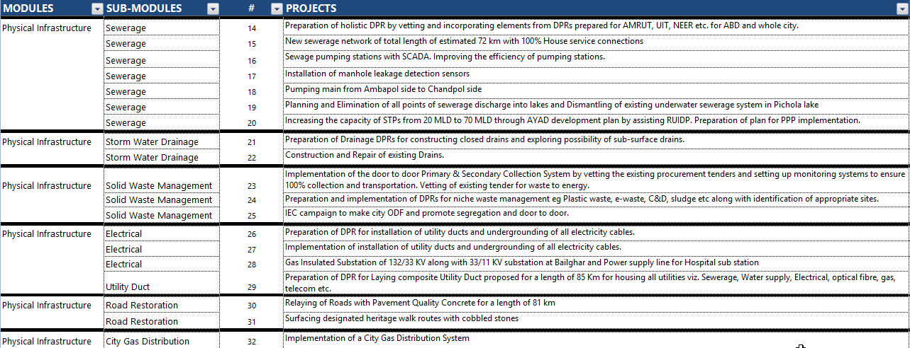
Udaipur Smart City
Projects – Core Infrastructure (Details)

Slide 15
Udaipur Smart City
Visible, Feel, Experience Projects
City Name | Smart Roads in Areas (ABD) – Nos. | Implementation Status | Smart Integrated Command & Control Centre | Implementation Status
Udaipur | TenderSURE not feasible as road width in the walled city area is too narrow For the rest of the Smart Solution Implementations will be done. The relevant DPRs are in process | NA | The construction of the Command and Control Centre is in progress. 3 modules are in progress Surveillance Analytics & Forensics Helpline A tentative layout plan of the Command and Control Centre has been prepared RFP HAS ALREADY BEEN PREPARED EXPECTED DATE OF RFP: FEBRUARY, 2017 | The construction of the Command and Control Centre is in progress. 3 modules are in progress Surveillance Analytics & Forensics Helpline A working prototype of the Command and Control Center is nearing completion with the following details Air Quality Monitoring System Camera feed from Tourist places Mapping of Community Toilets in the map of Udaipur Community Hall Online Booking Status City Bus Service Application Solid Waste Vehicle GPS Tracking System LED Lighting Application

Slide 16
Udaipur Smart City
Projects – “Smart” Solutions
City Name | Proposed Projects (No.) | RfP under Preparation | Work Started (Nos) | Discuss – Plan of Action for RfPs under Preparation | Physical Progress (% completed)
Udaipur | 9 | 7 | 1 | The Study, Analysis and the feasibility options are being discussed with the stakeholders along with demo and presentations from the interested parties

Slide 17
Udaipur Smart City
Projects – “Smart” Solutions (Details of the Projects)
RfP under Process
N.B. The Cost is based on the pro rated Budgeted Cost available against the individual modules from the TOR. This has been done because of the absence of individual Budgeted Cost of line items
For Details on Progress made: Refer Slides 18-21

Slide 18
Udaipur Smart City
NEW WORKS PROPOSED
SL. NO. | MODULE | PROJECTS | REMARKS /EXPECTED DATE OF ISSUE OF RFP
1 | URBAN MOBILITY | Traffic Management System | EOI issued for Traffic Booth under NMT on 24-08-2016 & received on 09-09-2016. POC issued to bidder for 9 months by Municipal Corporation with the consent of RTO & Traffic police.
2 | SMART SOLUTIONS - Smart Utilities & ICT Applications | Smart Parking Management System with parking sensors | Work completed related to the preparation of RFP for Smart Parking Sensors in the 10 designated Parking locations across the City Technical Specifications have already been prepared by the PMC EXPECTED DATE OF ISSUE OF RFP: IT WILL BE PART OF THE TENDER DOCUMENT THAT WILL BE FLOATED WITH RESPECT TO SMART SOLUTIONS – ICT → FEBRUARY, 2017

Slide 19
Udaipur Smart City
NEW WORKS PROPOSED
SL. NO. | MODULE | PROJECTS | REMARKS /EXPECTED DATE OF ISSUE OF RFP
3 | URBAN MOBILITY | Development of bus stands and smart bus shelters | Proposal for Bus Q Shelters has been prepared. RFP has been completed. EXPECTED DATE OF ISSUE OF RFP: FEBRUARY, 2017
4 | URBAN MOBILITY | GPS enablement of buses as per UBS II, which would be integrated with Command & Control Centre and real time information dissemination to passengers through Passenger Information System | GOR is giving 35 buses to Udaipur town under AMRUT mission. Buses will be run by Udaipur City Transport Limited. UIT has finalized the land for bus depot and O&M expenditure will be borne by UIT and Nigam equally. Draft Tender document already prepared by MCU
5 | URBAN MOBILITY | Implementation of Smart Car Parking Management System | Work underway related to the preparation of RFP for Smart Parking at Gulab Bagh Work related to Structural Design and Architectural Design is in progress EXPECTED DATE OF ISSUE OF RFP: FEBRUARY, 2017

Slide 20
Udaipur Smart City
NEW WORKS PROPOSED
SL. NO. | MODULE | PROJECTS | REMARKS /EXPECTED DATE OF ISSUE OF RFP
6 | URBAN MOBILITY | Smart Parking at Chandpole and Gulab Bagh | Planning and Designing is in Progress Structural Design for the same will be started in a week’s time
7 | SMART UTILITIES & ICT APPLICATIONS | Smart Card Common City Payments System for Udaipur | USCL invited offer on non-exclusive basis Selected bidder shall issue pre-paid card Co-branded with USCL and Financial Institution. Card will facilitate collection at govt. entities and tourist places. Card will provide an interface for the card users that allow them to check the balance of the card, load the card and transfer the money to his Bank Account of choice. There will be no rentals and transactional charges for POS device to Government Entities Proposal for the same has been received
8 | URBAN MOBILITY | Cycle Sharing under NMT | Tender invited to develop 10 cycle stands in the city to promote NMT Technical Bid has been opened on 31-01-2017. Financial Bid will be opened on 21-02-2017

Slide 21
Udaipur Smart City
NEW WORKS PROPOSED
SL. NO. | MODULE | PROJECTS | REMARKS /EXPECTED DATE OF ISSUE OF RFP
9 | URBAN MOBILITY | Preparation and Execution of small bridge near Daiji ka Pulia to resolve the traffic congestion in the said area. | Structural Design is in progress for the same. EXPECTED DATE OF RfP: MARCH, 2017
10 | URBAN MOBILITY | Preparation of comprehensive mobility plan for the entire city | Framework for the CMP is in progress for the same. Projects identified in the SCP have been listed. Further elaboration of the projects, suitable additional projects that may be taken up, cost estimate and phase wise listing of projects are to be done
11 | URBAN MOBILITY | Introducing restrictions on vehicular traffic in walled city in a phased manner and promotion of pedestrianisation | First draft of the document has been completed and submitted for review.
12 | SMART UTILITIES & ICT APPLICATIONS | Laying of Optical Fibre and Smart Wi-Fi Solutions | RFP for the same has been prepared and submitted for Review EXPECTED DATE OF ISSUE OF RFP: FEBRUARY, 2017

Slide 22
Udaipur Smart City
Projects – “Smart” Solutions (Details of the Projects)
1. Urban Mobility and Social Infrastructure
Revised Tentative Date of Issue of RfP : 28th Feb, 2017
2. Upgradation to Smart Transportation Vehicles
Revised Tentative Date of Issue of RfP : 28th Feb, 2017
3. Implementation of Smart Bus Shelters
Revised Tentative Date of Issue of RfP : Feb, 2017

Slide 23
Udaipur Smart City
Projects – “Smart” Solutions (Details of the Projects)
4. Smart Transportation Facilities
Revised Tentative Date of Issue of RfP : 28th Feb, 2017
5. Smart Utilities & ICT Applications - Infrastructure
Revised Tentative Date of Issue of RfP : Feb, 2017
6. Development of a Traffic Management System
Revised Tentative Date of Issue of RfP : March, 2017

Slide 24
Udaipur Smart City
Projects – “Smart” Solutions (Details of the Projects)
7. Smart Utilities & ICT Applications - Designing and Development of Applications
Revised Tentative Date of Issue of RfP : 31st Mar, 2017
8. Implementation of Smart Car Parking Management System
Revised Tentative Date of Issue of RfP : Feb, 2017
9. Installation of Smart Poles and VMS Boards
Revised Tentative Date of Issue of RfP : Mar, 2017

Slide 25
Udaipur Smart City
Projects – ABD
City Name | Proposed Projects (No.) | RfP under Preparation | Work Started (No) | Physical Progress (% completed)
Udaipur | 39 (34 + 5 Quick Wins) | 19 | 9 | Open Air Gym and Solar roof top in government buildings have been completed Smart Classrooms and Heritage Conservation work is under progress The construction for Command and Control Centre has started REFER SLIDE 3-4 FOR DETAILS

Slide 26
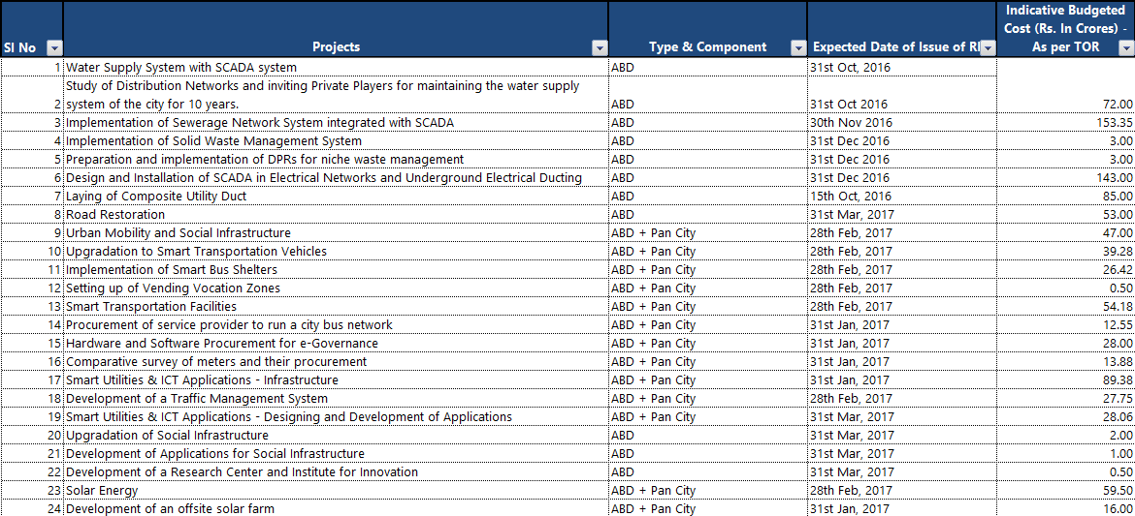
Udaipur Smart City
Projects – ABD

Slide 27
Udaipur Smart City
Projects – ABD
N.B. The Cost is based on the pro rated Budgeted Cost available against the individual modules from the TOR. This has been done because of the absence of individual Budgeted Cost of line items
Projects already started/completed (Refer Details in Slides 3-4)
Development of Open Air Gymnasium at Gulab Garden
Conservation & Development Works of Heritage façade, Lighting & Signage’s for Historic Bazaars in the Walled City, Udaipur under package for Udaipur Smart City Project Phase-I
Setting up Smart Class Rooms in Government Schools of walled City Area Udaipur
Installation of Solar roof top in government buildings in the ABD (walled city) area
Construction of Control and Command centre Building

Slide 28
Udaipur Smart City
REVIEW OF PROGRESS OF PROJECTS
PROJECTS FOR WHICH TENDER HAS BEEN ISSUED…
SL. NO. | NAME OF WORK | BRIEF DETAIL
1 | Parking lot development work at PWD Garrage near Gulab Bag, Udaipur | To provide parking facility in the wall city area
2 | HERITAGE CONSERVATION- Conservation of Baories under ABD area | As a part of the heritage conservation taken up in the ABD (Walled City Area), USCL has identified many old baories in the Walled City which are in a very bad state and needs conservation. Following up the same the Company has earmarked 8 Baories and has made the sanction of Rs 51.10 Lacs to conserve the said 8 step wells(Baories) of the Walled City. Tender issued and will be received on 21-02-2017
3 | SEWERAGE- Construction of 3 STP of 40 MLD (25+10+5) capacity under HAM | It will include commissioning of three STP at: 5 MLD- near Karjali house 10 MLD near FCI Godown; and 25 MLD at Eklingpura The same has been retendered on 16-02-2017. VALUE OF THE TENDER: INR 80 CR.
4 | SEWERAGE - Providing, laying, jointing, testing and commissioning of sewer system and all ancillary works in AMRUT Phase-II area including 1 year defect liability and thereafter 10 years O&M for Udaipur town | Tender has been floated with respect to AMRUT Phase II worth to the tune of INR 75 Crores on 16-02-2017

Slide 29
Udaipur Smart City
REVIEW OF PROGRESS OF PROJECTS
PROJECTS FOR WHICH TENDER HAS BEEN ISSUED…
SL. NO. | NAME OF WORK | BRIEF DETAIL
5 | GREENING AND ENVIRONMENT - Development of Parks, , Orchid Garden and Setting up of Roof top Gardens | RfP already prepared for the setting up and operation of an adventure zone in Manikya Lal Varma Park and has been floated The scope of work will broadly include development of adventure zone, pertinent structures, infrastructure and facilities, operation and maintenance of the complete facility for a period of 10 years (License Period). USCL intends to develop adventure zone with activities for all the segments of tourists. The Tentative List of Adventure activities suggested under the tender includes Zip Line/Aerial Runway All-Terrain Vehicle (ATV) Zorbing Trekking and Hiking Commando Slithering Trampoline Butterfly Park Underwater Walk Theme based weekly night bazaar

Slide 30
Udaipur Smart City
Convergence – GoI, State Government, Others
Name of City: Udaipur
Name of Ministry/Department/Others | Nos. of Projects | Cost of Project(s) | Status
Ministry of Urban Development | 1 | INR 75 Cr | Work commenced for Rs. 5.75 Cr ,for remaining the same is yet to be processed
Ministry of Power | 1 | INR 0.22 Cr | DPR approved, Revised Tender submitted to GOI worth Rs. 1.29 Cr.
Ministry of Petroleum and Natural Gas | 1 | INR 80 Cr | Tender reissued
For Details: Refer Slides 31-32

Slide 31
Udaipur Smart City
Convergence – GoI, State Government, Others
(A) Progress of SBM
Municipal Corporation declared 15 wards ODF and 30 wards will be made ODF by Dec. 2016.
Work Order issued for construction of 600 individual household toilets.
15 auto tippers have been purchased; fabrication for segregation will be complete in one week and door to door will start in 25 wards.
(B) Progress in AMRUT
Service Level Improvement Plan (SLIP) prepared under AMRUT scheme as per the fund allocated to Udaipur. In sewerage and septage component Rs. 85 Crore were sanctioned in 1st phase.
In the sanctioned work, the area closed to lakes was covered in 1st phase, which is ABD area. Amount Rs. 5.75 Cr will be in this wall city area.
Work started with respect to Sewerage Work of amount Rs. 75 Cr
(C) SMART RAJ
Following services started under Smart Raj:
Door to door household survey under progress for UD Tax. 40,000 household completed and approved. This will be uploaded on UD Tax module by 30th Nov.
Fire NOC/ application has been received online, fee has been deposited and NOC will soon be generated.
Marriage and Birth/ Death – marriage registration applications are being received online and digitally signed certificates are being issued through Pehchan Portal. Birth and Death certificates are also being issued through Pehchan Portal.
Building Permission – part of the module architect registration has been done. There are certain issues regarding plan uploading which are being sorted out by Smart Raj.

Slide 32
Udaipur Smart City
Convergence – GoI, State Government, Others
(D) Progress in IPDS
AVVNL submitted the revised DPR to GOI and is under the process of approval.
(E) Progress in PNG
Petroleum And Natural Gas Regulatory Board sanction the work for Udaipur and invited tender " Bid No.: PNGRB/CGD/BID/7/2016 " for laying, building, operating or expanding city or local natural gas distribution network in the geographical area of Udaipur District.
In view of large number of representation received from interested bidders on the issue of uncertain/ distant natural gas pipeline connectivity, the Board deferred the bidding. Revised bidding schedule will be again issued by Board

Slide 33
Udaipur Smart City
Finance – PPPs and JVs
City Name | Proposed PPP in SCP (Total No.) | Process Started (No) | Likely date of bidding | Proposed Private Finance (Rs. Crores) in bidding
Udaipur | 6 | 2 | Refer Next Slide | Refer Next Slide

Slide 34
Udaipur Smart City
Finance – PPPs and JVs (Contd.)
PROJECT DETAILS
RfP under Process/Completed
N.B. The Cost is based on the pro rated Budgeted Cost available against the individual modules from the TOR. This has been done because of the absence of individual Budgeted Cost of line items

Slide 35
Udaipur Smart City
Other Works …

Slide 36
Udaipur Smart City
NEW WORKS PROPOSED
SL. NO. | MODULE | PROJECTS | REMARKS /EXPECTED DATE OF ISSUE OF RFP
1 | SMART SOLUTIONS - Greening and Environment | Installation of Ambient Air quality Monitoring facilities . | Rajasthan Government has launched mobile application RajVayu for sharing information about air quality index of Udaipur. The same will be integrated with the initiative related to installation of Ambient Air Quality Monitoring facility. Work is under progress to get the same propagated through installation of VMS Screens across the City as also the ones that are currently in place
2 | SMART SOLUTIONS - Greening and Environment | Lake Conservation – Real time water quality monitoring probes , floating wetlands and aeration systems | Options mooted for the installation of a water quality monitoring system at prime locations in the City (Fateh Sagar, Goverdhan Sagar, etc.) and its transmission through VMS Boards EXPECTED DATE OF ISSUE OF RFP: TBD

Slide 37
Udaipur Smart City
NEW WORKS PROPOSED
SL. NO. | MODULE | PROJECTS | REMARKS /EXPECTED DATE OF ISSUE OF RFP
3 | SOLAR ENERGY | Installation of Solar Roof Top plant in Government and Private Buildings in the Udaipur city | USCL is going to install roof top solar plants in all the government buildings under RESCO model. RFP WITH RESPECT TO INSTALLATION OF SOLAR PANELS ON ROOF TOP OF GOVT. BUILDINGS WILL BE FLOATED IN FEBRUARY, 2017
4 | SOLAR ENERGY | Offsite Solar Plant Installation | A land of 10 hectare has been proposed at Tiger Hill for Installation of the offsite Solar Plant. The feasibility study of the land has been carried out by consultant IRADe. The land belongs to UIT and proposal of allotment of land has been approved in the trust meeting. USCL is going to install off site solar plant with the agreement with REIL under RESCO model.

Slide 38
Udaipur Smart City
NEW WORKS PROPOSED
Junction Improvement – Surajpole Junction
USCL and Nagar Nigam jointly started the junction improvement work with the technical assistance of ICLIE, Smart City Partner of Udaipur. Junction redesigning and planning has been done by ICLIE and the detail modal was discussed with transport, police and local administration than practical demonstration successfully implemented with the help of traffic police. Now USCL is going to implement the plan.
Landscape design option have been finalized and work is in progress for the purpose of floating a tender for the same.
Smart Utility
Installation of electric meter will be done under MBC model. Proposal for this MBC model has been sent to MD AVVNL. For water meter letter has been sent to SE PHED
Ayad Promenade Development
Work is in progress and preliminary concept note shared with Client in line with the same
Alternate Route between Brahmpol and Chandpol
Work is in progress with respect to the construction of an alternate route between Brahmpol and Chandpol

Slide 39
Udaipur Smart City
PROPOSED WORKS NEXT IN THE PIPELINE
Preparation of RFP related to the installation of VMS Boards aimed at display of public messages and awareness generation of Government‘s social sector schemes
Development of a Research Center and Institute for Innovation – It will serve the following 4 purposes
Assisting in Technology Start-ups – Linkages with Banks, AMDIC and targetted at Welfare of the Minorities
MoU with Students from Prestigious Institutes to encourage their entrepreneurial initiatives – Linkages with VCFs’
Living Heritage – Encouragement of Initiatives related to the promotion of art and culture of the region
Initiaitives related to Solar Park and establishment of a Solar Cell with a view to encourage initiatives in line with making Udaipur the Solar City of India
Development of Water and Health ATMs
Setting up rooftop gardens in walled city, vertical gardens at suitable locations, cross- utilisation of electric clamps for holding green pots and incorporating greenery in placemaking of squares, plazas and ghats.
Preparation of audio guides for various identified tourist places.
Smart Traffic Signalling systems (including 3D Zebra Crossings)

Slide 40
Udaipur Smart City
Thank you …

