Slide 1
OLabs www.olabs.edu.in
Products/Solutions/Expertise of C-DAC Mumbai in Smart City Domain

Slide 2
About OLabs
Project Title
Online Labs (OLabs) for school experiments
Participating Organizations
C-DAC Mumbai & Amrita Vishwa Vidyapeetham
Target Audience
Schools, students & teachers
Subjects
Physics, Chemistry, Biology, Mathematics & English
Classes Covered
Class IX, X, XI, XII

Slide 3
Background
Experiments and assignments aid learning in several ways and schools are increasingly getting oriented with more practical focus.
Experiments have not received their due importance and emphasis in science study in their schools. The reasons can be:
Infrastructure required for conducting various experiments is not always available in all schools
In view of difficult logistics involved in assessing experimental work for large number of school students, the assessment of experiments has not been as serious as that of the theory part of the curriculum
Olabs is partial attempt to altercate these problems and enhance the practical component in schools

Slide 4
OLabs Lab Details
Available in
English
हिंदी
മലയാളം
मराठी

Slide 5
Salient Features
Web based access
All labs are available for free access on http://www.olabs.edu.in .
Experiments and evaluation component aligned to CBSE curriculum.
Interactive Simulations which model real life environment and behavior.
Includes features such as recording observations, plotting graphs, calculations, generating lab sheet, etc which enhance the overall learning experiment.
DVD and Windows installer version available on request.

Slide 6
OLabs – Innovative features
Authentic content suitable for learners’ need
Complete ecosystem of learning for each experiment/lab
Aligned to CBSE curriculum
Various mode of access to Olabs – Web, Windows Installer, Live DVD
English Lab - a novel concept
Usage in Multiple Scenarios
For demonstration, explanation
For self-learning, revision & exploration
Pre and Post Lab

Slide 7
Technologies & Standards
Process model - ISO 9001:2008 R&D process model of SDG, CDAC Mumbai
Technologies
Server side : JSP, Servlets, Spring, Hibernate
Languages: Java, PHP
Database : MySQL
Client side : Javascript, JQuery, HTML5, CSS3, Kinetic JS, Three.js, Geogebra,
Framework : Spring, Spring MVC, Hibernate
Bug tracking – MantisBT
Code Versioning – GIT

Slide 8
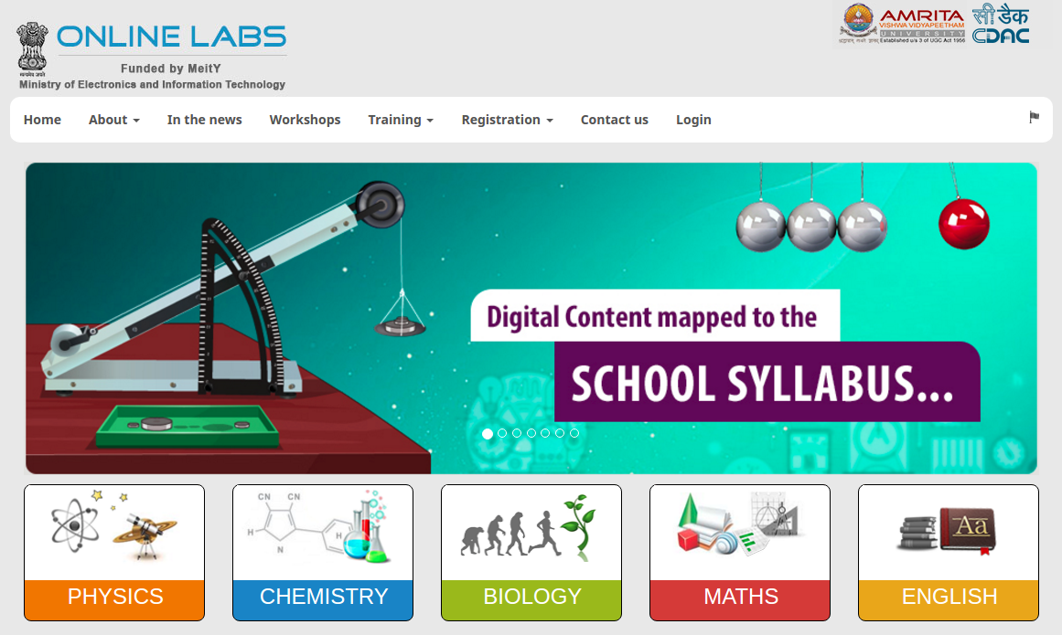
OLabs Homepage

Slide 9
Outer Structure of an Experiment

Slide 10
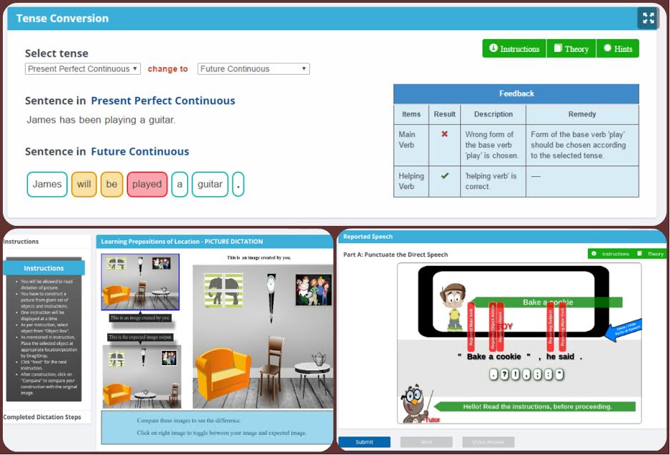
English labs in action

Slide 11
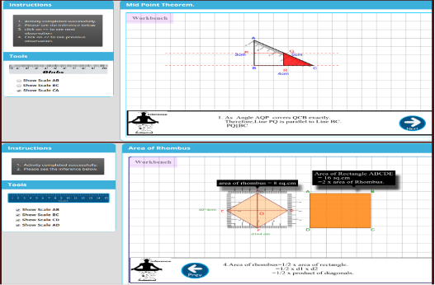
Mathematics labs in action

Slide 12
List of Project Awards & Achievements
CBSE Circular & Endorsement – Feb 2013
CBSE Circular & Endorsement – April 2016
CSI IT Excellence Award 2013
SKOCH Order of Merit in 2013
NASSCOM Innovation Awards 2013 (shortlisted for Jury award)
Presentation to Chairman at CIPS.
OLabs launch at Good Governance week celebrations by Honourable minister of IT Shri Ravi Shankar Prasad
Rollout of Online Labs project was accepted by Miety.

Slide 13
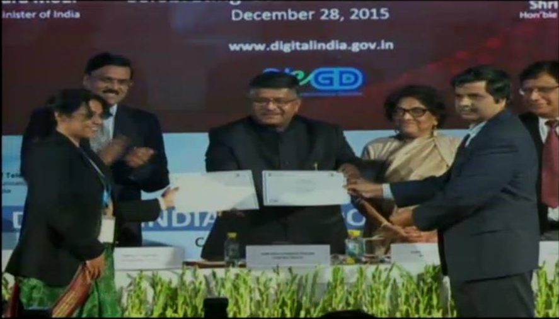
Launch of Online Labs
OLabs was launched during Good Governance week celebrations on Dec 28, 2015 by Honourable minister of IT Shri Ravi Shankar Prasad
Notes:
NextGen eSolutions (P) Ltd.
13

Slide 14
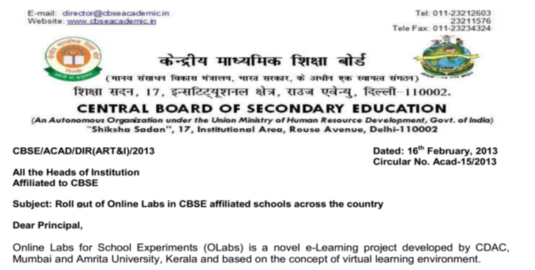
CBSE Circular & Endorsement – Feb 2013

Slide 15
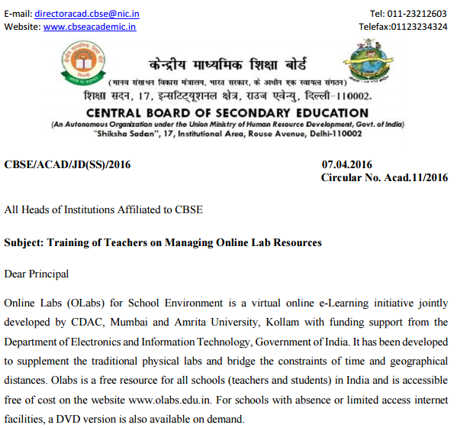
CBSE Circular – April 2016

Slide 16
OLabs – Awards
CSI IT Excellence Award 2013
SKOCH Order of Merit
NASSCOM Innovation Awards 2013 (shortlisted for Jury award)

Slide 17
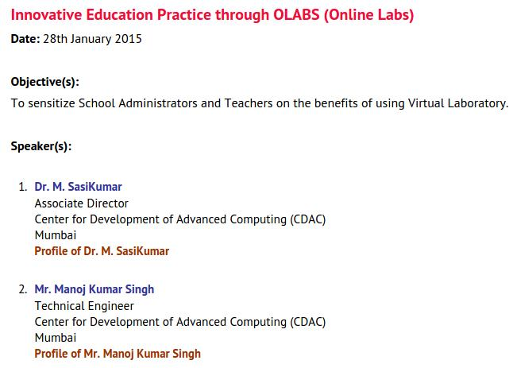
Olabs workshop at CIPS using Video Conferencing
Participated States
Teachers from 28 locations of 16 states have participated in the VC.
800 other participants were facilitated with Webinar which includes Live Chat on the VC.
This topic has also been showcased in the Programme conducted afternoon, the same day, along with other two topics for participants from Hyderabad.
Around 16 states participated.

Slide 18
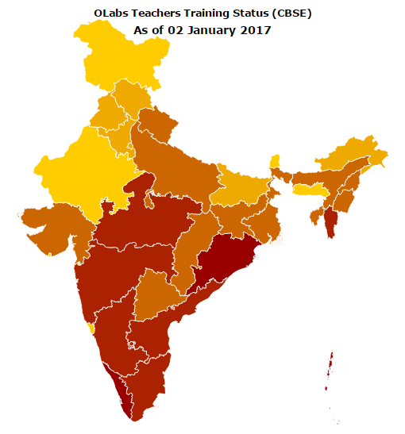
State | No. of teachers trained
Andaman and Nicobar Islands | 120
Andhra Pradesh | 178
Arunachal Pradesh | 11
Assam | 81
Bihar | 19
Chandigarh | 120
Chhattisgarh | 144
Delhi | 154
Gujarat | 177
Himachal Pradesh | 15
Haryana | 115
Jharkhand | 238
Karnataka | 771
Kerala | 3762
Maharashtra | 972
Madhya Pradesh | 827
Odisha | 684
Punjab | 94
Telangana | 122
Tamil Nadu | 1199
Uttar Pradesh | 520
Uttarakhand | 260
Manipur | 7
Mizorum | 4
Tripura | 13
Nagaland | 3
West Bengal | 102
Total | 10712
OLabs Training Status

Slide 19
Thank You

