Slide 1
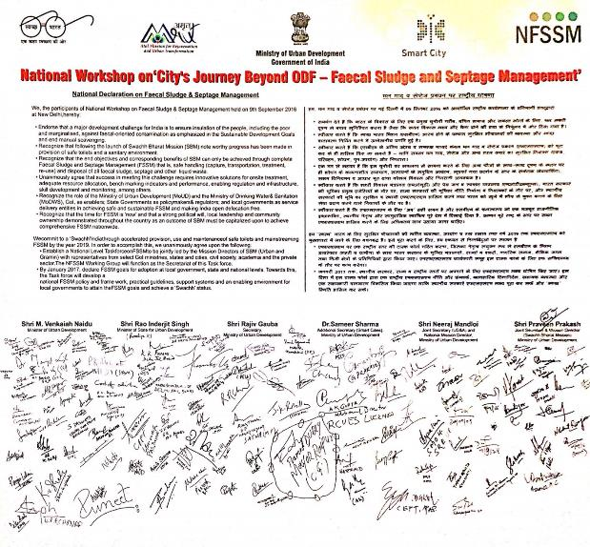

Slide 2
SFD in India - 2011
Containment
Emptying
Transport
Treatment
Reuse/
Disposal
13.9%
WC
Centralized System (11.9%)
Effectively Treated (5.2%)
5.2%
Not Effectively Treated (3.08%)
Leakage includes DEWATS
(3.6%+ 0.2%)
Decentralized systems (2%)
Effectively Treated (1.4%)
1.4%
Not Effectively
Treated (0.45%)
6.7%
36.18%
On-Site Facility
Safely Emptied (31%)
Legally dumped (9.3%)
Not Effectively Treated (9.21%)
Illegally dumped (21.7%)
0.1%
Safely Abandoned (0.09%)
Un-Safely Emptied (5.18%)
50%
OD / Open Discharge
93.3%
5.2%
21.7%
3.8%
49.9%
12.7%
Domestic Environment
Agriculture field
Receiving Waters
Data Source Census 2011

Slide 3
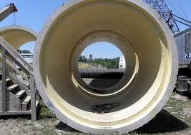
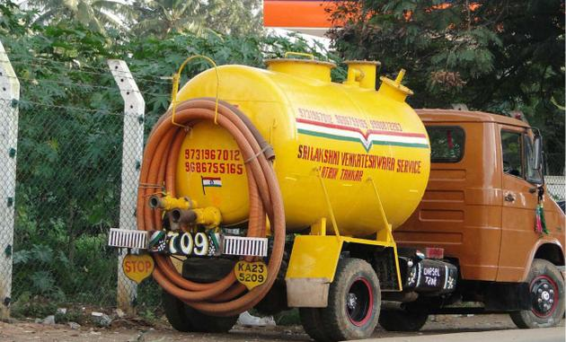
Urban Sewage in 2025
Containment
Emptying
Transport
Treatment
Reuse/
Disposal
26%
WC
Centralized System (20%)
Effectively Treated (12%)
12%
Not Effectively Treated (3%)
Leakage includes DEWATS (5%+0.6%)
Decentralized systems (6%)
Effectively Treated (4.6%)
5%
Not Effectively
Treated (0.81%)
19.5%
59%
On-Site Facility
Safely Emptied (48%)
Legally dumped (26.0%)
Not Effectively Treated (26. %)
Illegally dumped (19.2%)
Safely Abandoned (2.88%)
3%
Un-Safely Emptied (11%)
15%
OD / Open Discharge
80.5%
11%
19%
6%
15%
30%
Domestic Environment
Agriculture field
Receiving Waters
Please see next page for key observations
CDD Society projections based on Census 2011

