Slide 1
Technology Options in FSM Part 1 Collection & Transport
Presented by
Amresh Sinha
CDD Society, Bangalore
CDD Society Bangalore
Date: December 23rd & 24th 2016
Place: Lucknow
Under Sanitation Capacity Platform (SCBP)

Slide 2
Sanitation Capacity Building Platform
What is it?
Collaborative effort by NIUA for Mainstreaming Fecal Sludge Management at the state level and national sanitation agenda. Working with Expert Partner organsiations for FSM solutions, upscaling of capacity building and national level advoacy with the NFSSM group.
We can help you!
We have sanitation challenges!
ULB
WASHi

Slide 3
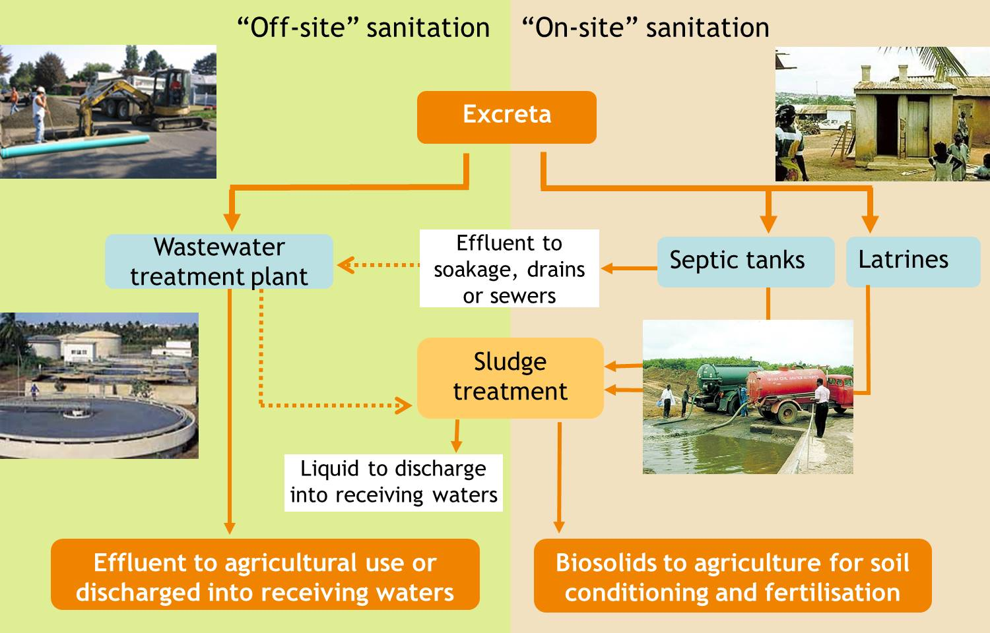
Sanitation options

Slide 4
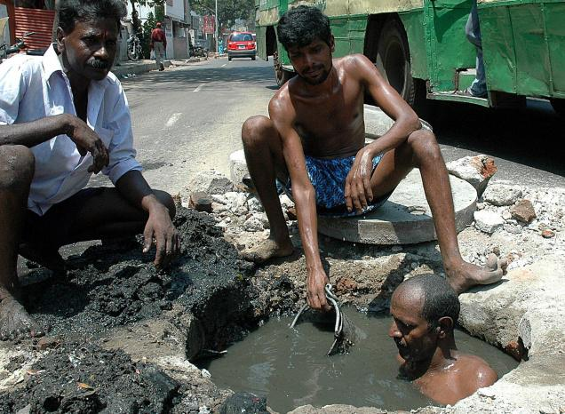
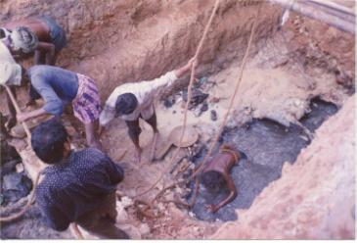

Slide 5
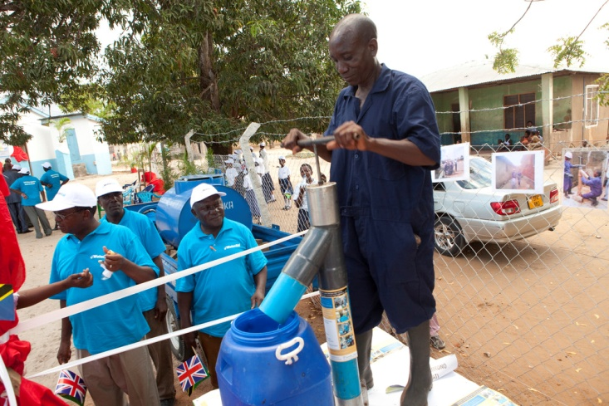
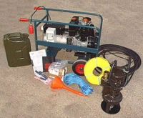
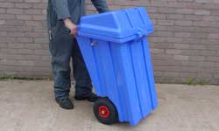
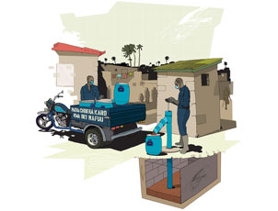
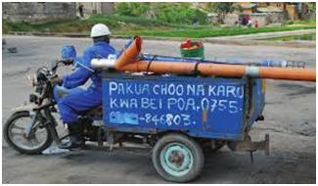
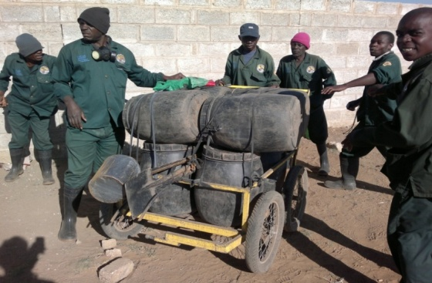
Collection & Conveyance
Very limited access to Vacuum tanks
Bucket System
Gulper System
Portable pump
TEMPRORY MESURE IMMEADATELY UPGRADED
With protective gears
Needs to be upgraded wherever possible immediately

Slide 6
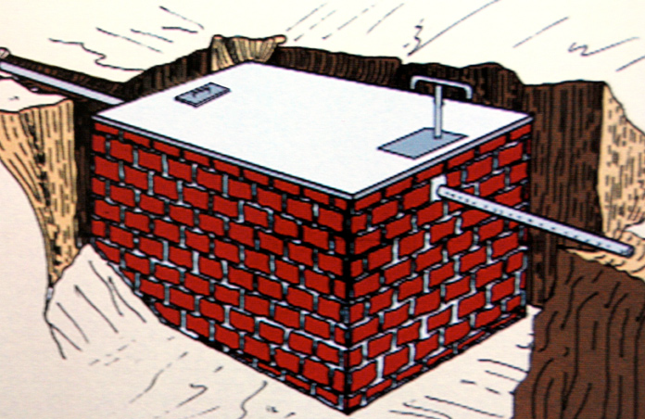
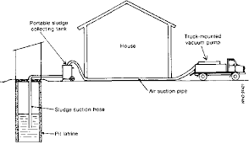
Collection & Conveyance
Very limited access to Vacuum tanks
Fixed /Mobile Transfer Station
Access to pits is very limited
Densely populated low income settlement with pits and limited road access
Permanent solution / constructed closer to the community where it can be accessible by large vacuum tank
Needs to be operated by community with the support of ULB

Slide 7
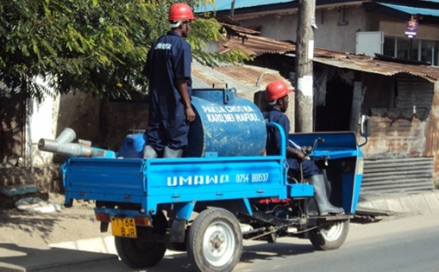
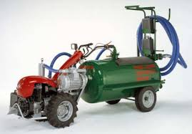
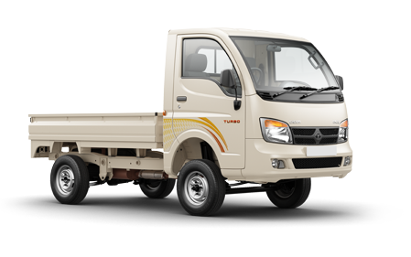
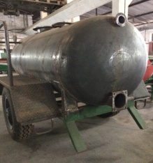
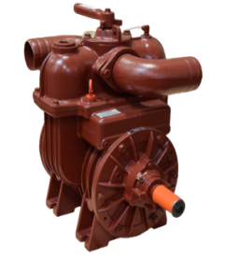
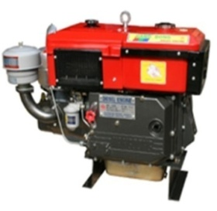
Collection & Conveyance
Limited access
Small Volume transport for roads with width less than 3 mtrs
Capacity – 1000, 2000 liters

Slide 8
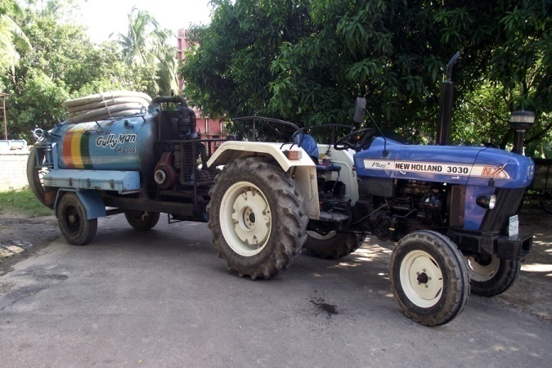
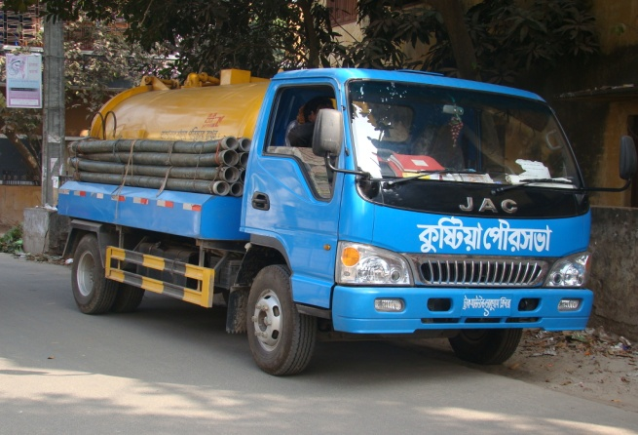
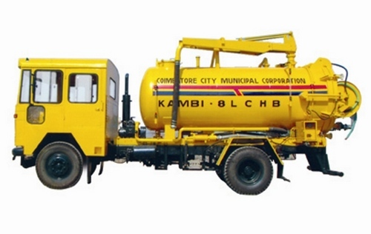
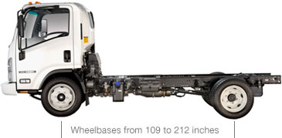
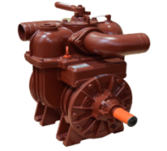
Collection & Conveyance
Adequate access
Large Volume Transport for roads with width more than 3 mtrs
Capacity – 2000, 4000 liters

Slide 9
Collection & Conveyance
Working principle
Operating principle of Vacuum pump – works on the concept of compression of air to create vacuum in the tank. Vacuum system with smaller quantity of sludge collection and storage.
Vacuum pump capacity = 2,500 TO 4,000 litres per minute
Type of energy = diesel engine or connected to the vehicle shaft (PTO)
Operating principle of Transport system: motorized transport system (mounted on chasis of motorized vehicle, mounted on trailer chasis) to carry large volume of sludge to treatment unit/disposal site with increased speed
Storage capacity varies from 500 lites to 10000 litres. Commonly used volume is 2000 and 4000 litres

Slide 10
Criteria for Selection
CAPEX
OPEX
Road width/ condition/ Terrain
After sale service/ skill for repair
Quantity of FS
Thickness and flow ability of FS
??

Slide 11
Thank You
www.niua.org
National Institute of Urban Affairs
Core 4B, India Habitat Centre, Lodhi Road
New Delhi 110003
011- 24617517
agupta@niua.org, jdash@niua.org

