Slide 1



Faecal Sludge Management:
Planning Process for Towns
Presented by
Amresh Sinha
CDD Society Bangalore
CDD Society Bangalore
Date: December 23rd & 24th 2016
Place: Lucknow
Under Sanitation Capacity Platform (SCBP)

Slide 2

Sanitation Capacity Building Platform
What is it?
Collaborative effort by NIUA for Mainstreaming Fecal Sludge Management at the state level and national sanitation agenda. Working with Expert Partner organsiations for FSM solutions, upscaling of capacity building and national level advoacy with the NFSSM group.
We can help you!
We have sanitation challenges!
ULB
WASHi

Slide 3
Sanitation Directly linked to Health
In India…
595 million people
do not use toilets and resort to unsafe open defecation
1000 children die
from unsanitary defecation practices, every day
65,000 tons of excrement are openly discharged, every day
43% of children
suffer from disease
caused by open defecation
One gram of feces has:
10,000,000 viruses
1,000,000 bacteria
1. $150,000 FSTP supporting 30,000 individuals
Sources: World Health Organization, UNICEF, United Nations

Slide 4
The Purpose of Sanitation
Sanitation infrastructure in India must achieve multiple goals:
1. Health and Safety
Completely separate faecal pathogens from human contact
Prevent pollution of fresh water sources (lakes, river, underground)
2. Water Management
Water supply is already a crisis and will become more serious
Freshwater reduced from 3,000 to 1,123m³ per capita over 50yrs
22 of 32 largest Indian cities face water shortage of 10-60%
Re-using water can increase water supply by 30-50%
3. Urban Beautification

Slide 5
What Cities Want
Treatment Option—address nuisance and pollution
End-to-End Faecal Sludge Management System
Licensing, Training, Regulating etc.
Better Sludge Transportation
Technical support
Management support
??

Slide 6
Wastewater Mgmt Infrastructure
Cities need a combination of sanitation infrastructure:
1. Centralized Sewerage Systems
Viable for densely populated areas with large CapEx and O&M budgets
2. De-centralized Wastewater Treatment Systems
Smaller, localized treatment systems—lower CapEx and O&M costs
Ideal for less densely populated areas, but also viable in large and dense cities
3. Faecal Sludge Management
Effective management of on-site containment systems (septic tanks, pits)

Slide 7
Comprehensive Urban Sanitation (1/2)
1. Centralized Sewerage Systems with Underground Drains
Suitable for dense cities—but difficult to scale as city grows
Require adequate water for effective operations
Expensive to build and maintain—CapEx Rs 20,000-25,000 per capita
Estimated effectiveness only 30-50%--due to power cuts, storm water
Disruptive to build—extensive digging of roads and private property
High potential for failure—several cases of unsuccessful projects
2. De-centralized Waste Water Treatment Systems
Much less expensive—CapEx Rs 4,000-7,000 per capita
Modular design for clusters—suitable even for large cities
Easier to implement—less digging required, easier to connect toilets

Slide 8
Comprehensive Urban Sanitation (1/2)
2. (contd…) De-centralized Waste Water Treatment Systems
Suitable for population 5-20,000—single home to entire neighborhood
Less complex, require less skilled staff—higher chance of successful O&M
Enables maximum local re-use of water, reducing fresh water needs
3. Faecal Sludge Management (FSM) for On-site Containment
Septic Tanks and Pits should be cleaned every 1-2 yrs to minimize soil/groundwater pollution
An effective treatment plant for faecal sludge, and safe Transportation of faecal sludge to the treatment plant, is critical
Ideally, treatment should allow safe reuse of water and sludge
Very low cost—under Rs 1,000 per Capita

Slide 9
Wastewater Infrastructure
7,000 towns with 400 Million people (600Mn by 2030)
All cities need combination of approaches to solve challenge:
Approach | Notes | Cap Ex per Capita
1. Centralized Sewerage Systems | Difficult and disruptive Many failed / partial treatment | Rs 20,000 [pop 200,000= Rs 400Cr]
2. De-centralized Wastewater Treatment Systems | Implement in phased manner Local re-cycling of water Regulations—bulk generators invest | Rs 4,000 – 6,000 [Rs 100Cr]
3. Faecal Sludge Management | Very simple, quick and low cost Need good logistics operations Technical skills not easily available | Rs 750 [Rs 15Cr]

Slide 10
Objective of FSM Planning
Health
No waterborne diseases
Clean rivers: drinking, recreation, aesthetics
Environment
No adverse nuisance / aesthetic issues
Resources Recovery
Energy efficient, low carbon footprint
Financial
Cost affordable and appropriate for community
Appropriate infrastructure / management : not too excessive / not too little ,
Alignment to National Policies, Adaptable

Slide 11

Identifying Planning Priorities
FSM Objectives
  Set objectives for your FSM Plan
  Set the boundary conditions
    Financial – within the budget available
    Geography – within the city boundary
    Timeline – within a fixed period of time
Objectives for your FSM Plan:
WHAT IS THE OBJECTIVE FOR YOUR CITY?
Notes:
What is your vision statement for your City?

Slide 12
Identifying Planning Priorities
FSM Objectives
  Set objectives for your FSM Plan
  Set the boundary conditions
    Financial – within the budget available
    Geography – within the city boundary
    Timeline – within a fixed period of time
Objectives for your FSM Plan:
By 2020, we will:
Reduce OD to 10% of existing levels
Reduce the number of unhygienic toilets by 50%
Ensure 100% compliance of newly built toilets to design standards by incorporating it in building approval protocol
Ensure 50% safe disposal of FS collected by vaccutugs operating in the area

Slide 13
FSM Planning Methodology
Conceptualization
Project Inception
Baseline Survey
  HH Survey
  Institutional Survey
    Financial Base
    Human Resource Capacity - organogram
    Municipal Service Delivery
  Detailed System Survey
  Assessment of Demand Supply Gap
Identifying Planning Priorities/Stress areas
  Defining Vision
  Identifying Strategies and Alternatives
    Technical Solutions
    Financing Options
    Regulations and Institutional requirements
Inception Stage
Interim Stage

Slide 14
FSM Planning Methodology
Consultation Meeting to validate Solutions
Investment Plan for the town
  Own Revenue Sources
  Social Venture Capital
Phasing Implementation Roll Out Plan
Implementation Roll Out
  Organising Technical Feasibility Study
  Validate identified Sub Projects
  Seeking clearances (IEE)
  Procurement of Engineering Services
  Operationalize O&M framework – by council resolution
Interim Stage
Final Stage
Execution Stage

Slide 15
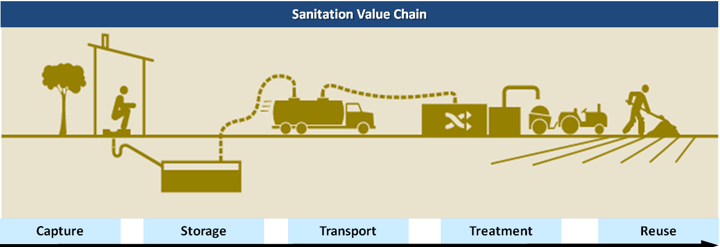
Baseline Survey – Assets and Stakeholders
User Interface
Containment
Collection & Conveyance
Treatment
Reuse
Individual Toilets
Public Toilets
Community Toilets
    Septic Tanks
    Single Pits
    Twin Pits
    Masons
    Manual Scavengers
    Desludging Operators
    Vehicle Manufacturers
    Centralised/ Decentralised STPs
    Operators
    Farmers
    Agri-input Retailers

Slide 16

Project Inception – Steering Committee Formation
Formation of Steering Committee
  Comprises of all stakeholder representatives
    Membership includes both government officials from the ULB council and representatives of citizens’ groups (ward counsellors) and other local stakeholders (visionaries)
    Representatives from the district administration; Department of Public Works Department; Social Welfare
    Diverse membership from the public, ranging from the elite in the town to its slum dwellers.
    Female members
  Main agenda – defining vision, planning and monitoring, providing guidance

Slide 17
Simplified Approach
Provide integrated turnkey service to municipality as PPP
Design, Build and Operate Faecal Sludge Treatment Plant
Also operate De-sludging Trucks, ensuring safe transportation, treatment and re-use of faecal sludge
Quick Data Analysis
O&M and Training
Build FSTP(s)
FSM Policy

Slide 18
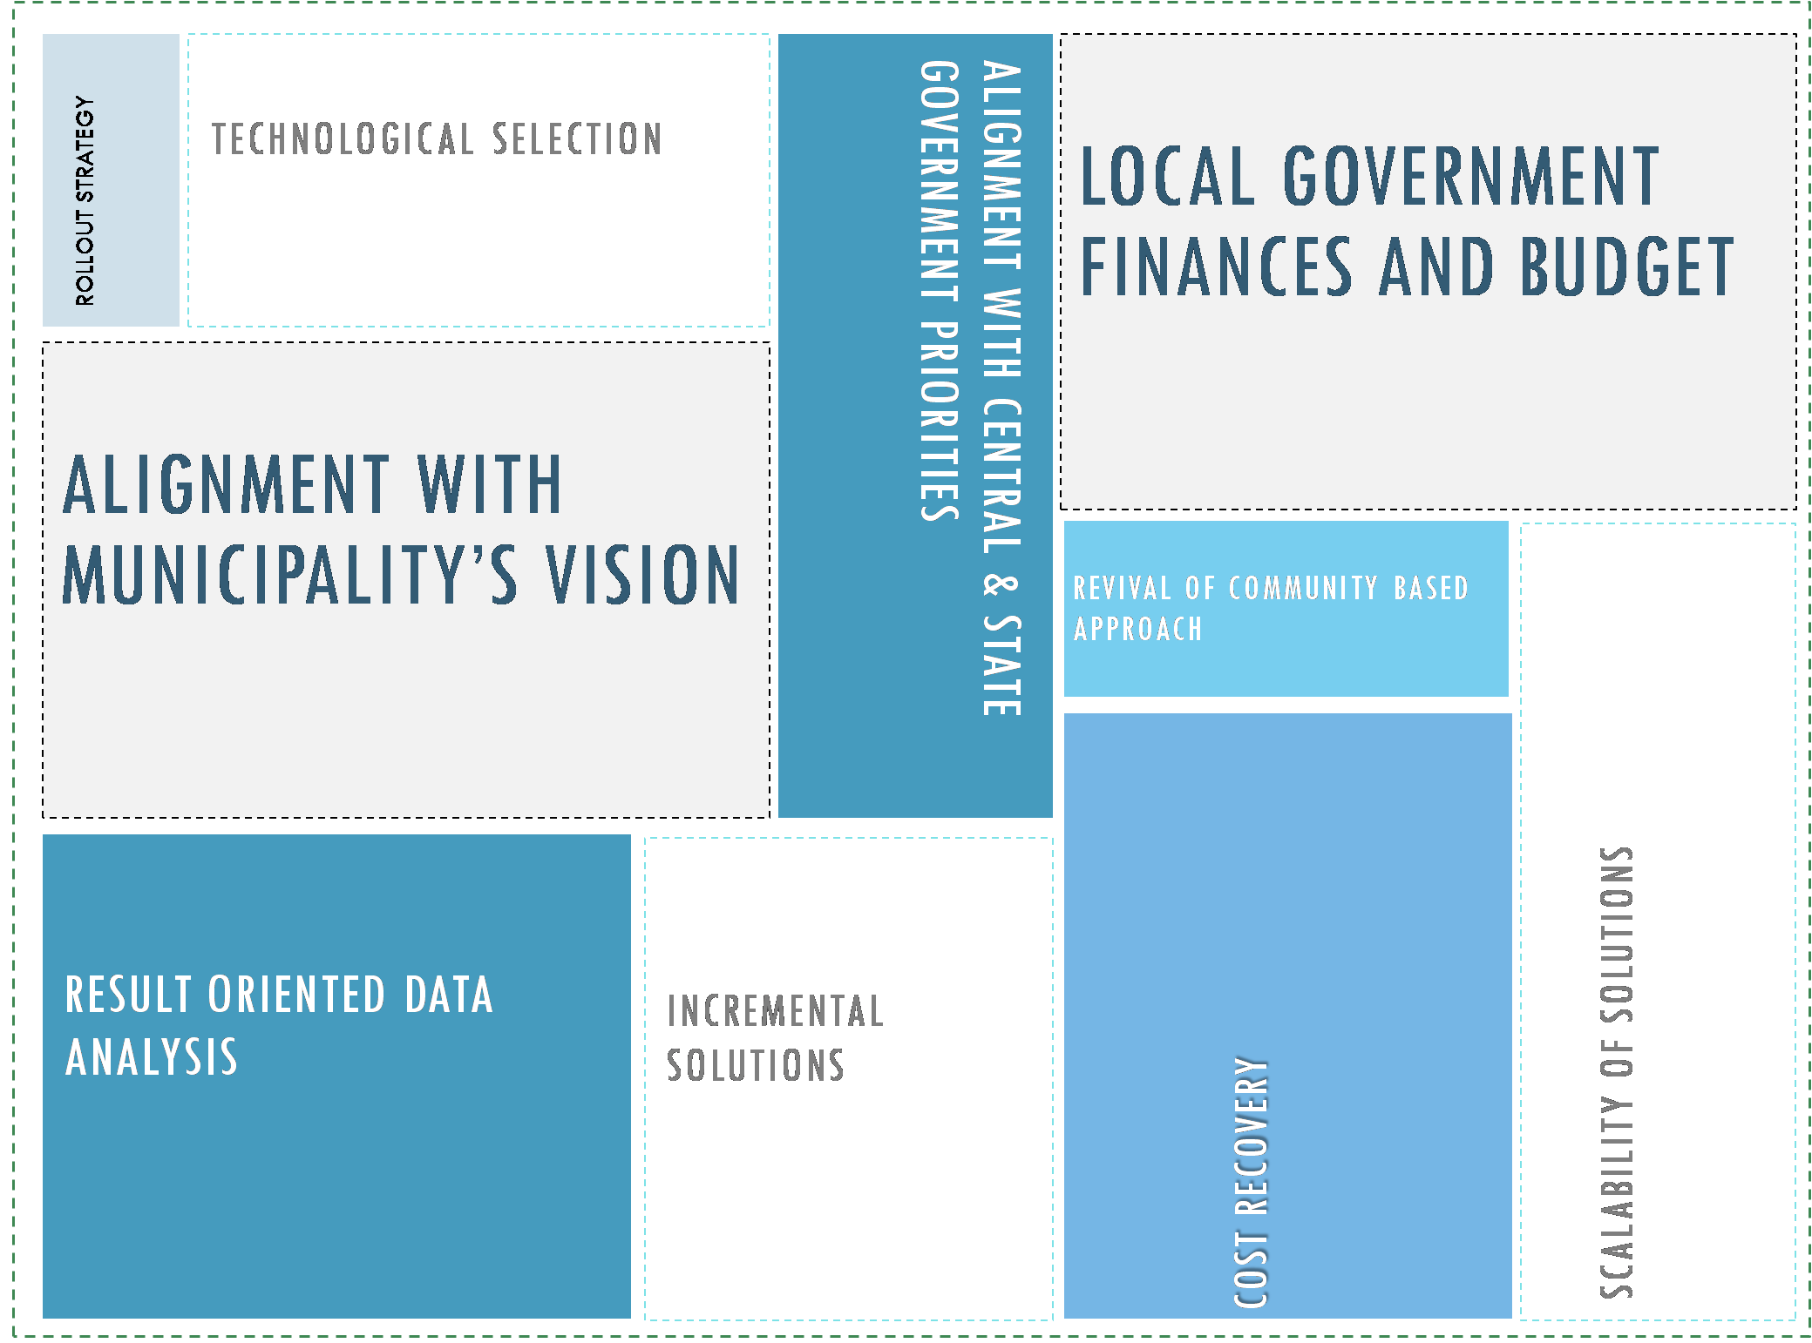
Conceptualization – Guiding Principles
Notes:
Alignment with Municipality’s Vision: Providing guidance but in complete collaboration with the municipality. At the end of the day, no plan however rigorous could be executed through to its rightful conclusion without the collaborative support of the municipality, also keeping in view their tacit experience in the town.
Local Government Finances and Budget: The solutions to be proposed across all segments of the sanitation value chain have to be sensitive to the municipal finance situation of the town to have any realistic prospect of moving into the implementation phase.
Alignment with Central and State Government priorities: The Central Government has reinstated its commitment to sanitation in 2014 with the launch of the Swachh Bharat Mission (Clean India Mission) and the Atal Mission for Rejuvenation and Urban Transformation (AMRUT), another scheme to improve the urban sector of the country.
Result Oriented Data Analysis: It has become clear that data collection only to back a cookie cutter solution will not help with creating an implementable CSP. Rather data collection methods should be driven with the specific purpose of solving the issue and serving a solution. For instance, sludge generation levels in a town, water supply consumption, wastewater generation if evaluated carefully across different user groups.
Scalability of solutions: The scale at which a solution (for e.g. a wastewater treatment or faecal sludge treatment unit) is provided will have a major bearing on the level of financial investment required in a town.
Incremental Solutions: We aim to adopt an approach of incremental improvement (in terms of interventions and investments) that could be sustained (technically, environmentally and socio-economically) over a period of time to address the entire sanitation value chain
Technology selection: Environmental implications; Operation and maintenance requirements; Land availability; Treatment efficiency; Energy requirements
Cost Recovery: : An implementable solution should have a cost recovery model to make it’s implementation sustainable
Revival of Community Based Approaches: Instead of only providing the sanitation “hardware”, sanitation implementation need to take a holistic approach
Rollout Strategy: It is important that the roll out of the implementation of a FSM plan has to be done strategically focused on addressing high priority issues in the immediate term and big ticket projects in the long term

Slide 19
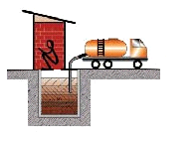
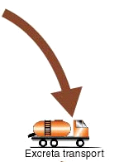
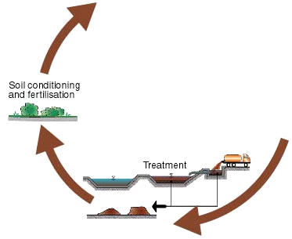
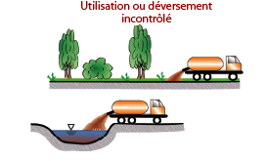
Non-technical aspects
FSM – Theory of Change
Well designed pits
and septic tanks
Tariff
Regular and safe
structure and
emptying of pits
and septic tanks
cost recovery
Efficient haulage
of FS (incentives/
enforcement
•
Advocacy
Safe
reuse
of
•
Capacity building
treated
faecal
•
Regulatory basis
sludge
in
•
Collaboration of
agriculture
stakeholders
/
aquaculture
Uncontrolled
Uncontrolled
disposal
disposal
or
or
reuse
reuse
Well designed
treatment facility
Appropriate treatment
O&M
©dorainarayana

Slide 20
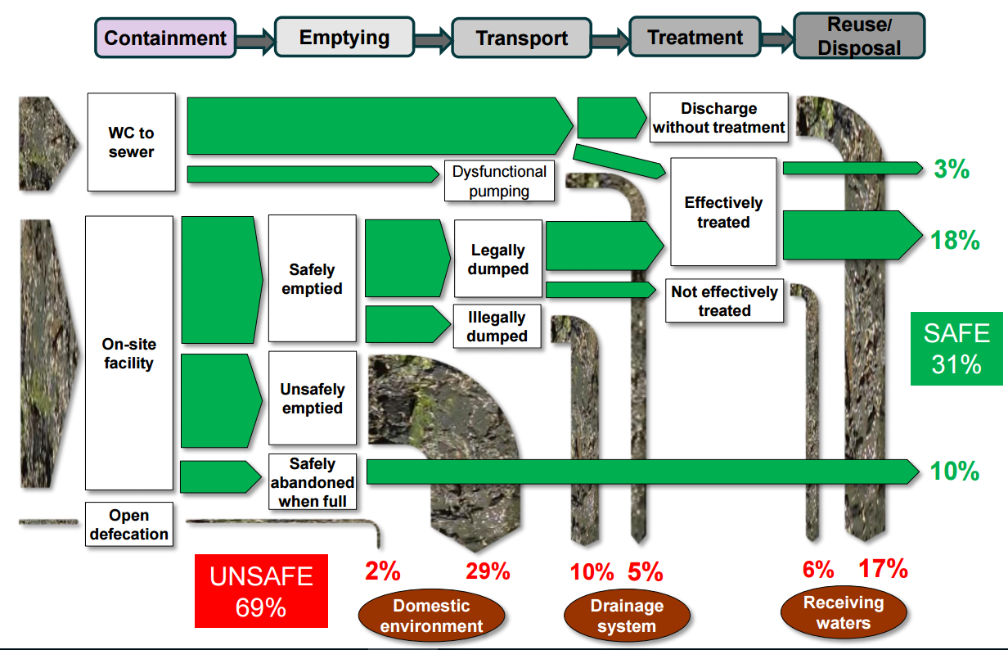
Assessment of Demand Supply Gap

Slide 21
Process to set up Treatment Facility

Slide 22
FSM Planning Aspects
PHYSICAL FACILITIES
AWARENESS
REGULATORY
INSTITUTIONAL
FINANCIAL
MANAGEMENT
CAPACITY
©dorainarayana

Slide 23
Toilets
ASSETS | AWARENESS | REGULATORY | INSTITUTIONAL | CAPACITY | MANAGEMENT
Build new toilets Upgrade toilets Build community toilets Financing scheme | Community level campaign School program Targeted households program | Regulations on toilet construction Specifications Licensing of contractors | Set up sanitation / FSM unit at local authority Training centre for contractors | Training for local authority staff Training and accreditation for contractors | Database & Record keeping Incentive schemes

Slide 24
Containment
ASSETS | AWARENESS | REGULATORY | INSTITUTIONAL | CAPACITY | MANAGEMENT
Construct new pits Upgrade existing pits Build new septic tanks Financing scheme | Community level campaign School program Targeted households program | Regulations on pits / septic tank construction Specifications Licensing of contractors | Set up sanitation / FSM unit at local authority Training centre for contractors | Training for local authority staff Training and accreditation for contractors | Database & Record keeping Incentive schemes

Slide 25
Transport
ASSETS | AWARENESS | REGULATORY | INSTITUTIONAL | CAPACITY | MANAGEMENT
Purchase new tankers Upgrade existing tankers Procure private operators with tankers Financing scheme | Community level campaign Awareness program for operators | Regulations on pits / septic tank emptying Specifications for tankers Licensing of operators | Set up sanitation / FSM unit at local authority Training centre for operators | Training for local authority staff Training and accreditation for operators | Database & Record keeping Incentive schemes Audit of FS trail

Slide 26
Treatment
ASSETS | AWARENESS | REGULATORY | INSTITUTIONAL | CAPACITY | MANAGEMENT
Build new facility Upgrade / expand existing facility Financing schemes | Community level campaign Awareness program for tanker operators | Regulations on treatment plant construction, operations, maintenance Specifications Licensing of operators | Set up sanitation / FSM unit at local authority Training centre for plant operators | Training for local authority staff Training and accreditation for plant operators Capacity building for related vendors and contractors | Database & Record keeping Audit of FS trail Performance monitoring

Slide 27
Reuse
ASSETS | AWARENESS | REGULATORY | INSTITUTIONAL | CAPACITY | MANAGEMENT
Upgrade existing plant to enable reuse New facility to incorporate reuse Financing schemes | Community level campaign Focussed campaign on potential users | Regulations on reuse / resource recovery Specifications for reuse water, bio solids, land application, and various uses Health and safety regulations | Set up sanitation / FSM unit at local authority Training centre for operators | Training for local authority staff Training and accreditation for operators | Database & Record keeping Incentive schemes Audit of FS residual reuse Continual monitoring

Slide 28

Financial Management

Slide 29
Sources of Revenue
 | FSTP | TRUCK OPERATIONS
CAPEX | Central and State Schemes Foreign Aid City Revenue | Private Players Central and State Schemes
OPEX | Property Tax Tipping Fees Advertising Space | Annual Maintenance Fee Fee per desludging Property tax (in case of PPP)

Slide 30
Capex and Opex
Costs Involved
Capital Expenditure
Operational Expenditure
Plant Cost
1 Cr/Plant
Cost per Capita
Rs 208
Cost of Truck Operations + Treatment
21 Lakh
Cost per person
Rs 150 Per Person Per Annum
Total Cost per Capita
Rs 358

Slide 31
Need for Financial Models
    1. Poor quality service
    Delays / poor service main reason people call private trucks
    2. Financial losses
    Neglect of assets a common story
    3. Private party can bring expertise and share investment
    4. Easy for Government to monitor and maintain

Slide 32
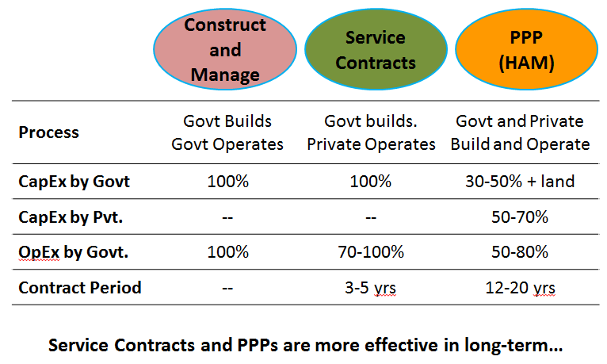
A quick comparison

Slide 33
Hybrid Annuity-based PPP Model
Cabinet recently approved under the Namami Gange program for wastewater treatment
Model popularized by the National Highways Authority of India
Hybrid of EPC and BOT Models - key features below
40% of Project Cost paid by Govt.
Payments made by Govt. to Private Party:
Annuity Payments for 15 years
O&M Payments
Interest Payments
Payments are made only if Private Party provides Services as expected
Benefit to Government:
Reduce initial investment
Pay only if services delivered as agreed by Private Party
Private Party fully accountable for O&M
60% of Project Cost paid by Private Party
Fees/Tax collected by Government
O&M by Private Party

Slide 34
HAM Model at a glance
Fixed Payments if work is done
GOVERNMENT
PRIVATE PARTY
Invest 30-50%
Provide land
Monitor performance
Invest 50-70%
Operating responsibility
SPV / Assets
Truck
FSTP
Revenue for Services
Market-based Revenues
Customers
Sale of By-Products

Slide 35
Financial Implications
De-sludging, Transportation and Treatment Plant
Population |  | 200,000 | 500,000
Total CapEx |  | Rs 14 Cr | Rs 35 Cr
Typically Paid by |  | Private Party for private trucks Government for Govt trucks and Plant
OpEx per Year |  | Rs 2 Cr / Yr | Rs 4 Cr / Yr
Typically Paid by |  | Services to Households (30-40%) Government (60-70%)
Cost to Govt (10Yrs) |  | Rs 34 Cr | Rs 61 Cr
Under PPP Structure:
Cost to Govt (10 Yrs) |  | Rs 12 Cr | Rs 30 Cr
Savings |  | Rs 22 Cr | Rs 31 Cr

Slide 36
Structure of the PPP
Standard Approach | Public-Private Partnership
Government invests in Trucks and Treatment Plant ULB operates truck and Plant, provide services, collect fees—complicated, difficult to monitor (typically 1-2 customers per day) ULB incurs 100% costs regardless of services provided to citizens | Role of Private Party: 100% of investment Complete operational responsibility Ensures proper service to citizens Role of Government/ULB: Zero investment—provides land only Pays Zero to 30% of Operating Costs—but linked to actual service delivery Monitor performance of Private Partner

Slide 37
Action Plan for Cities
Include FSM Budget in next Years Financial Allocation before 31st March
Form a Steering Committee on FSM
Invite tender for PMC -Identify Technical Partner /Consultants
FSM Situation Assessment - Survey
Preparation of DPR for FSTP/FSM
Identifying Funding for Potential FSM intervention
Consultation workshop – All Stakeholders
Execution of Transport , Treatment and Reuse Plans
Set up Monitoring Body

Slide 38
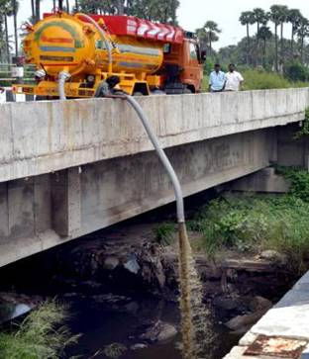
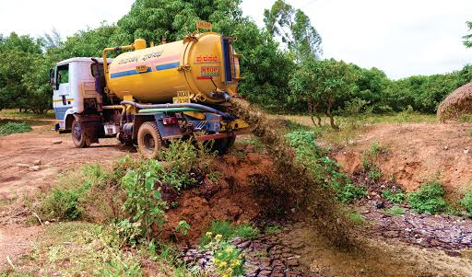
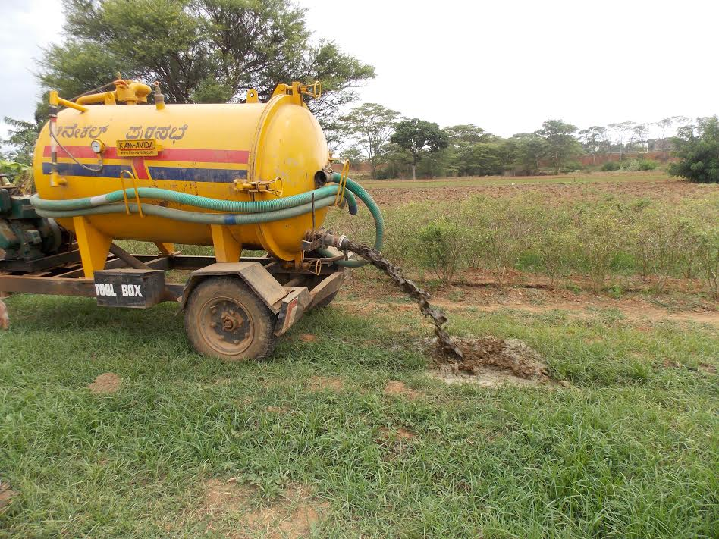
The Situation Today

Slide 39
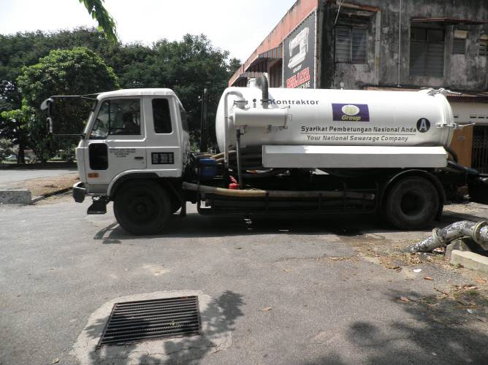
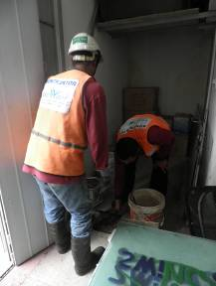
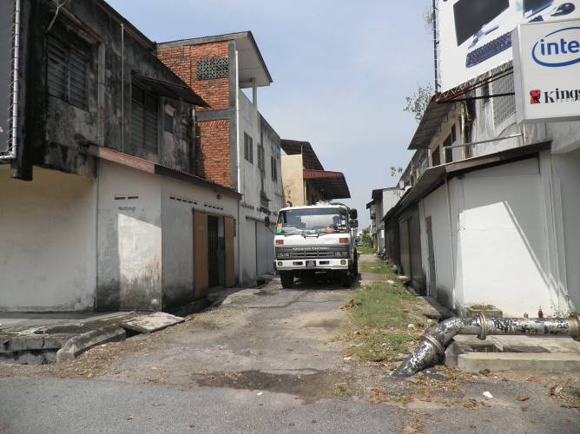
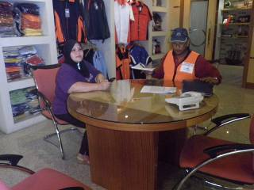
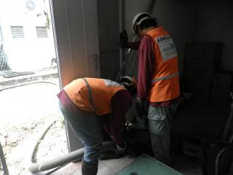
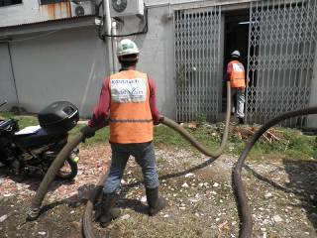
Our Vision of FSM

Slide 40
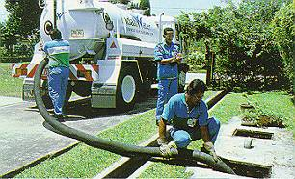
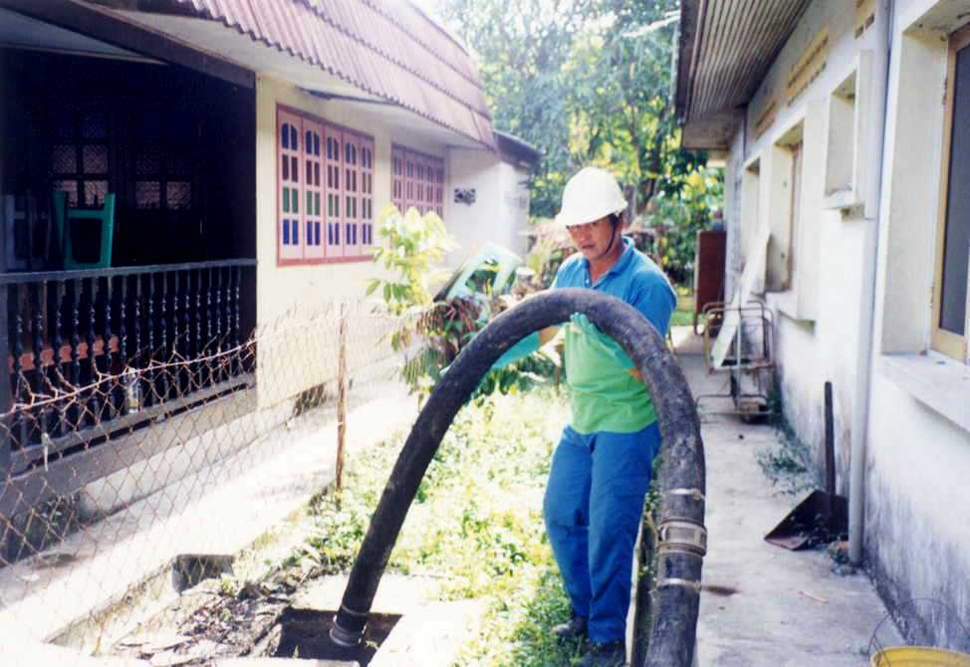
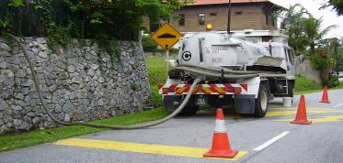
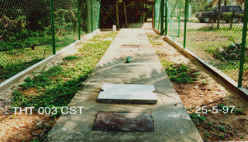
Our Vision of FSM
Notes:
Visualization of a IST is by the presence of a metal (or sometimes concrete) cover over a concrete area located at the back of the house or the side.

Slide 41

Thank You
www.niua.org
National Institute of Urban Affairs
Core 4B, India Habitat Centre, Lodhi Road
New Delhi 110003
011- 24617517
agupta@niua.org, jdash@niua.org

