Slide 1
Online Workshop 7 Towards the first milestone

Slide 2
Corridor for pilot
300 metre testing stretch
from Kranti Chowk to
Osmanpura Circle
Selected stretch for pilot
Kranti Chowk to Railway Station
Corridor Length
3 kilometres
Width
12 to 18 metres
Type of site
Commercial and institutional establishments

Slide 3
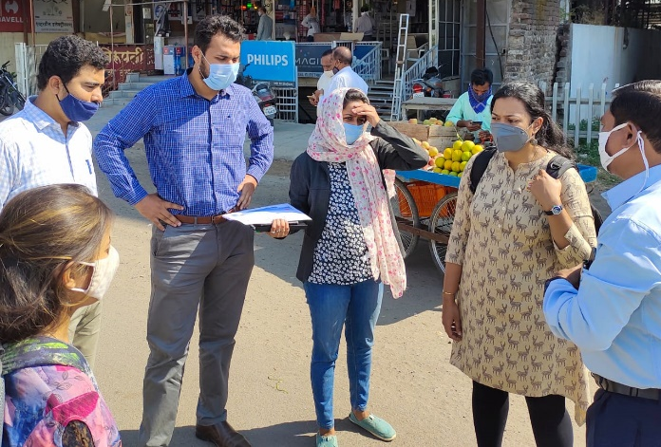
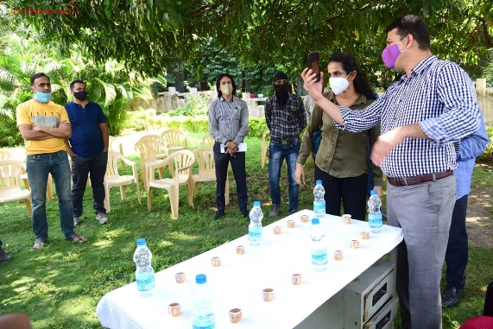
Involving Stakeholders
Discussions held with Cyclist Associations and fitness groups Site visits with Aurangabad Municipal Corporation and Aurangabad Smart City Development Corporation Ltd Officials One on one meets with shopkeepers and property owners Discussed designs with traffic police officers on site
1

Slide 4
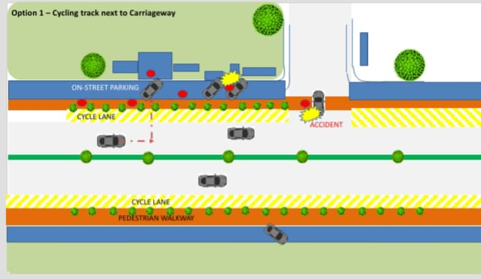
Brainstorming before designing

Slide 5
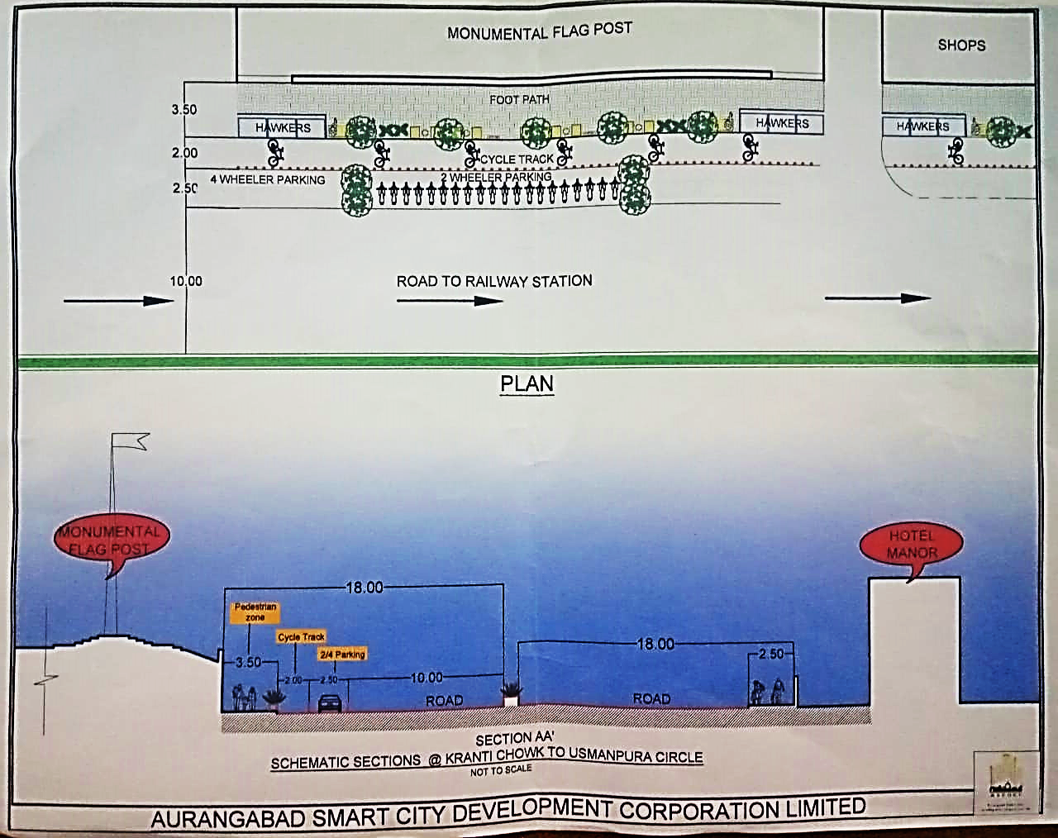
Design
The testing design allocates 10 metres for carriageway 2.5 metres for on Street parking 2.5 metres for cycle track 3.5 metres for pedestrians + hawkers In the design, the on-street parking comes right after carriageway followed by on-street parking, followed by cycle track and then footpath

Slide 6
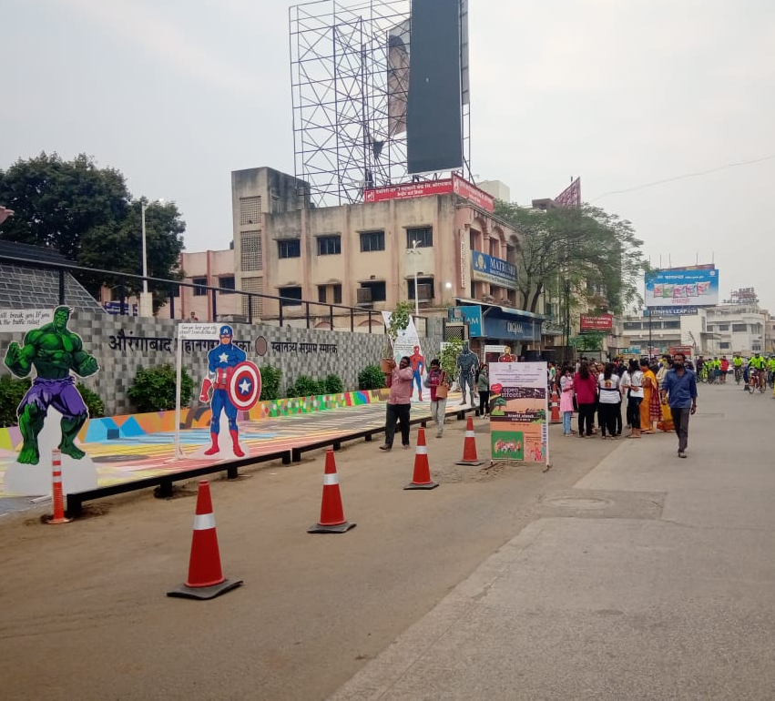
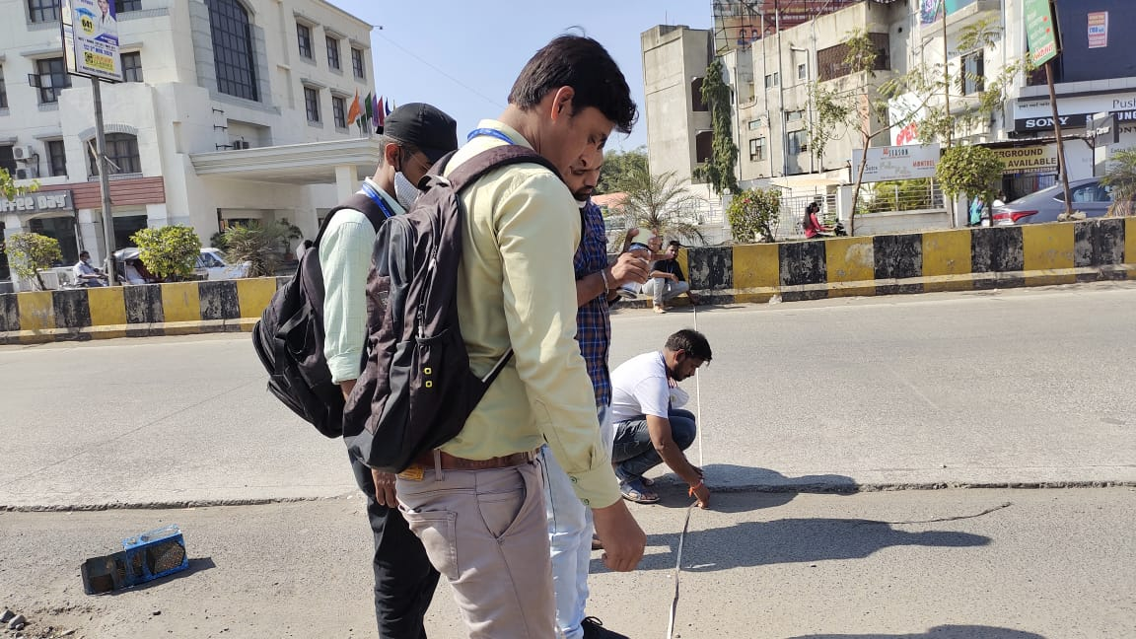
Testing
300 metre stretch was taken up for testing Temporary marking done on 3-kilometre stretch by citizen volunteers Later, we placed cones on the selected corridor stretch to test the design Joined the cones with flagging tape

Slide 7
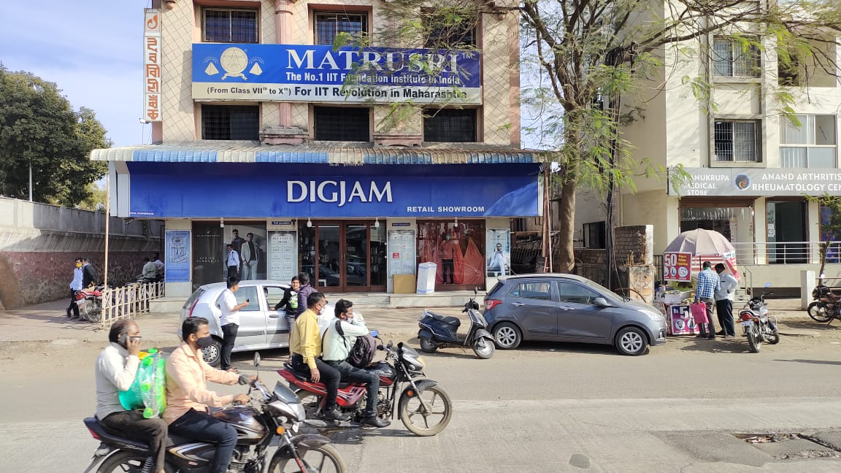
Learnings
Absence of signage fails the very purpose of cycle track
The cycle track, on-street parking cannot run uniformly throughout the stretch as some complexes need more parking than others Two wheelers will have to be allowed to park on paved space infront of establishments Cars can be given parallel on-street parking right next to carriageway Signage will have to be given at an elevation. People tend to ignore cycle track marking on road. Hawkers’ sharing the space will face each other and not road
Different buildings have different parking requirements

Slide 8
Next step
Implementing the modified design to the pilot stretch
On-Street parking will be removed from the spots where the road tapers leaving space for only cycle track and footpath
Signage denoting cycle track, no parking/ on street parking, turns to be installed along the line of bollard
Bicycle box to be painted at the turns to safeguard cyclists against speeding vehicles as they turn
Bollards to be installed perpendicular to the cycle track to prevent vehicles to enter the cycle track

Slide 9
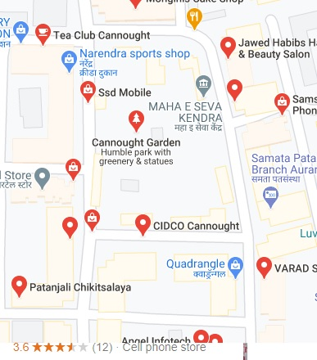
Neighbourhood
Connaught Place is selected for neighbourhood pilot
The area is 4.5 sq km
It has commercial as well as residential zone
The unorganised parking is a major concern in the area
The haphazard parking makes it inconvenient for the cyclists

Slide 10
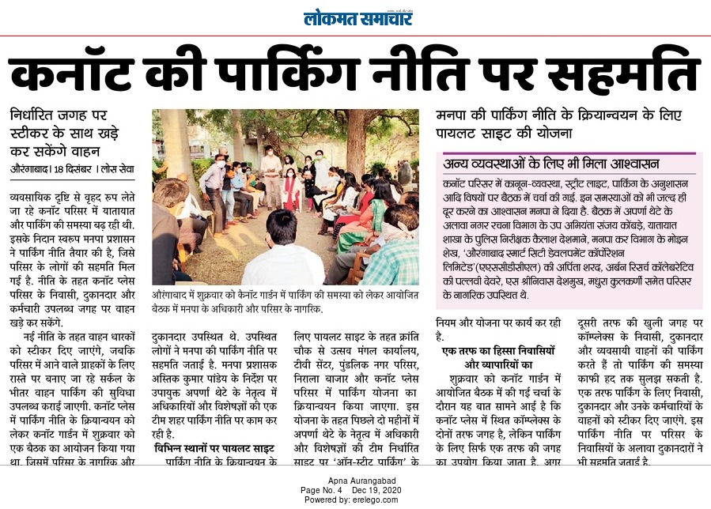
Interventions
Stakeholders meeting was held involving resident and commercial representatives The Aurangabad Municipal Corporation and Aurangabad Smart City Development Corporation Ltd. officials along with the local experts were successful in convincing the residential complexes to open parking for the employees and owners of commercial establishments The solution to parking problem is a boon to cyclists

Slide 11
Timelines
Corridor
Finalising design- December 30
Installation of bollards, signage - First week of January
Marking for on-street parking, bicycle box- Second week of January
Implementation of the design on entire corridor stretch- January 31
Neighbourhood
Implementation of parking policy- First week of January
Installation of signage, marking- January 15
Improvement in street lightning- December 30
All planned interventions to be implemented by January 31

Slide 12
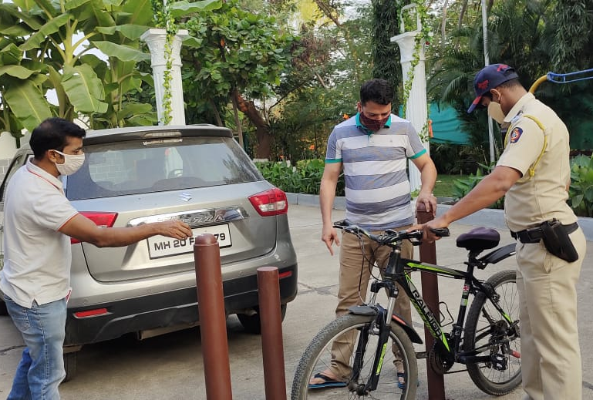
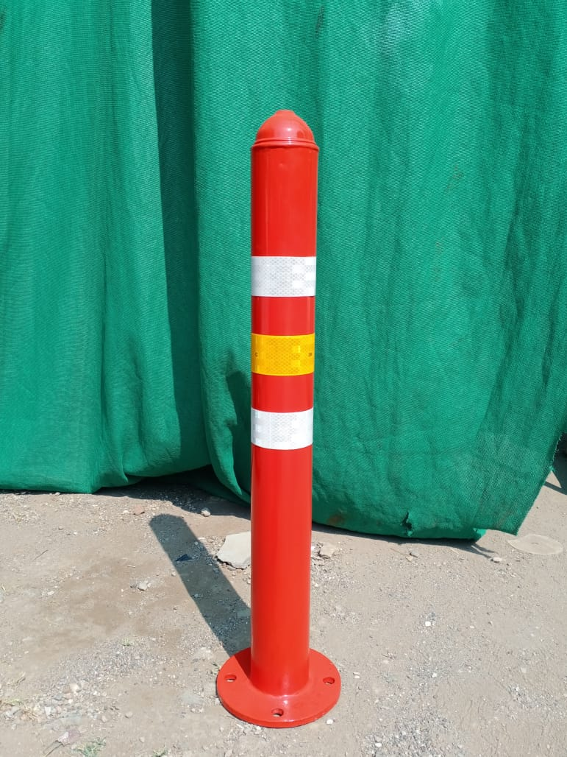
Innovations
In order to save costs Aurangabad Smart City CEO came with the idea of using old abandoned streetlight poles as bollards
Bollards made out of old poles

Slide 13
Budget estimation
Installation of bollards and signage – Rs 8 lakh
Road Markings – Rs 5 lakh
Minor road and footpath repair – Rs 1 lakh
Budget- Rs 14 lakh for Corridor and Neighbourhood Pilot

Slide 14
Cycle To Work Day Is Practiced Every First Day of the Month in Aurangabad Smart City

